Slide 1

Spherical and Conical Thin Shells
Advanced Structural Design
prof. Gianpaolo Rosati
2026-09-01
Dipartimento di Ingegneria Civile ed Ambientale

Slide 2
Shells of Revolution (Domes)

Slide 3
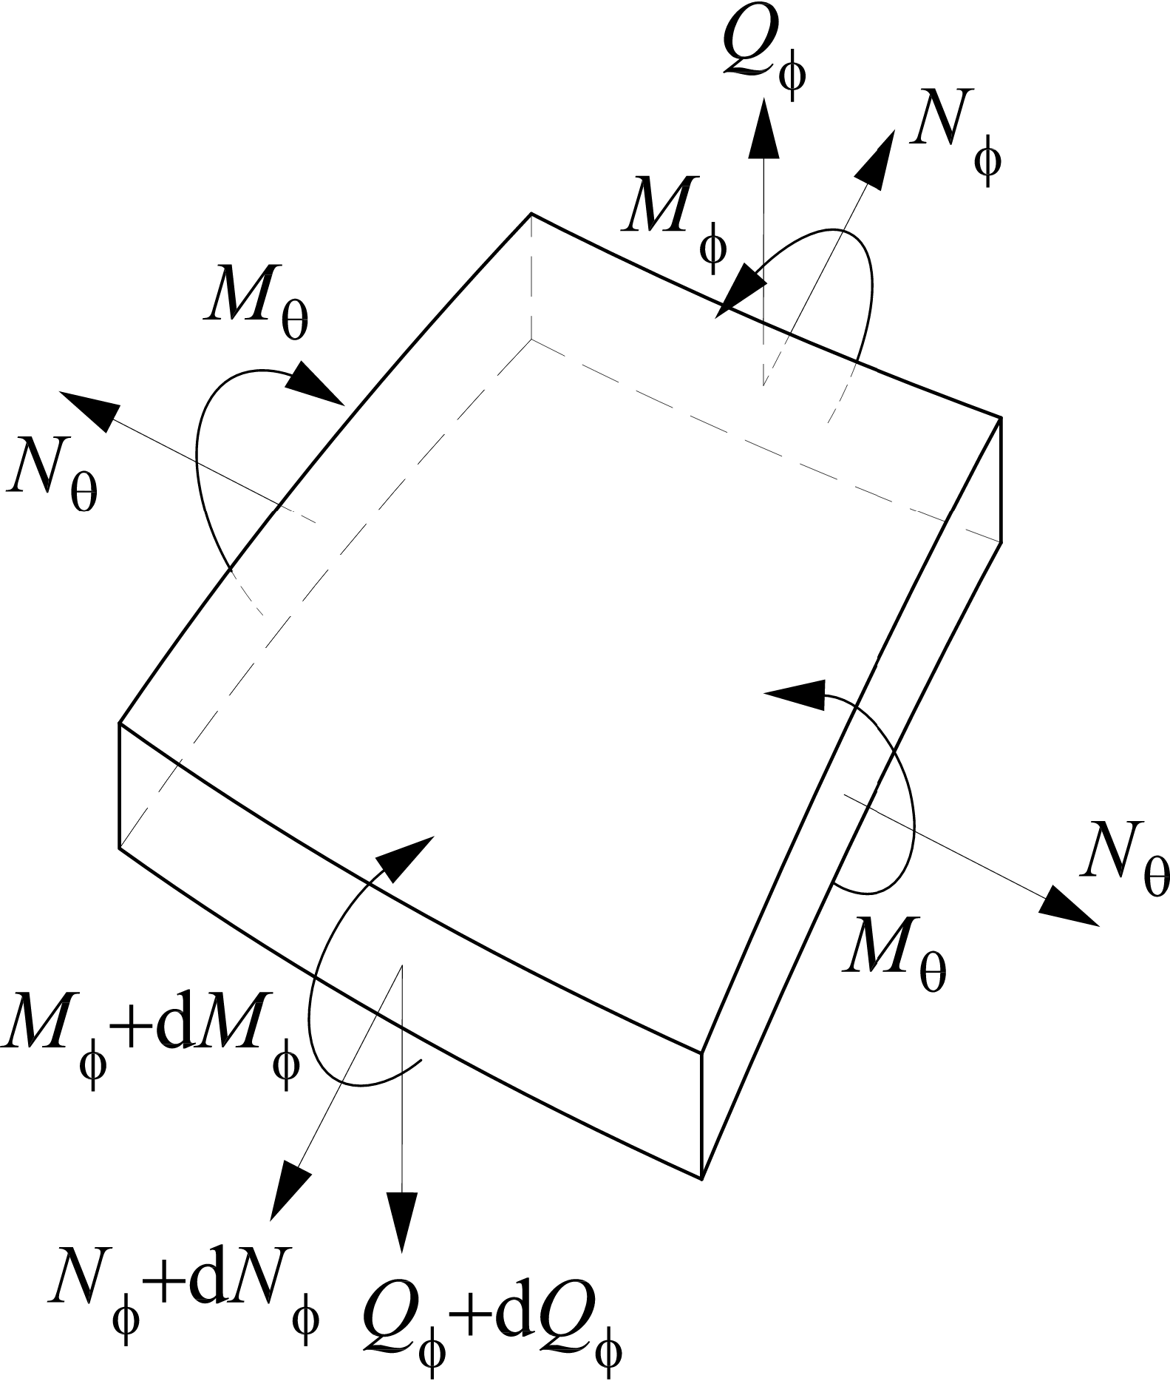
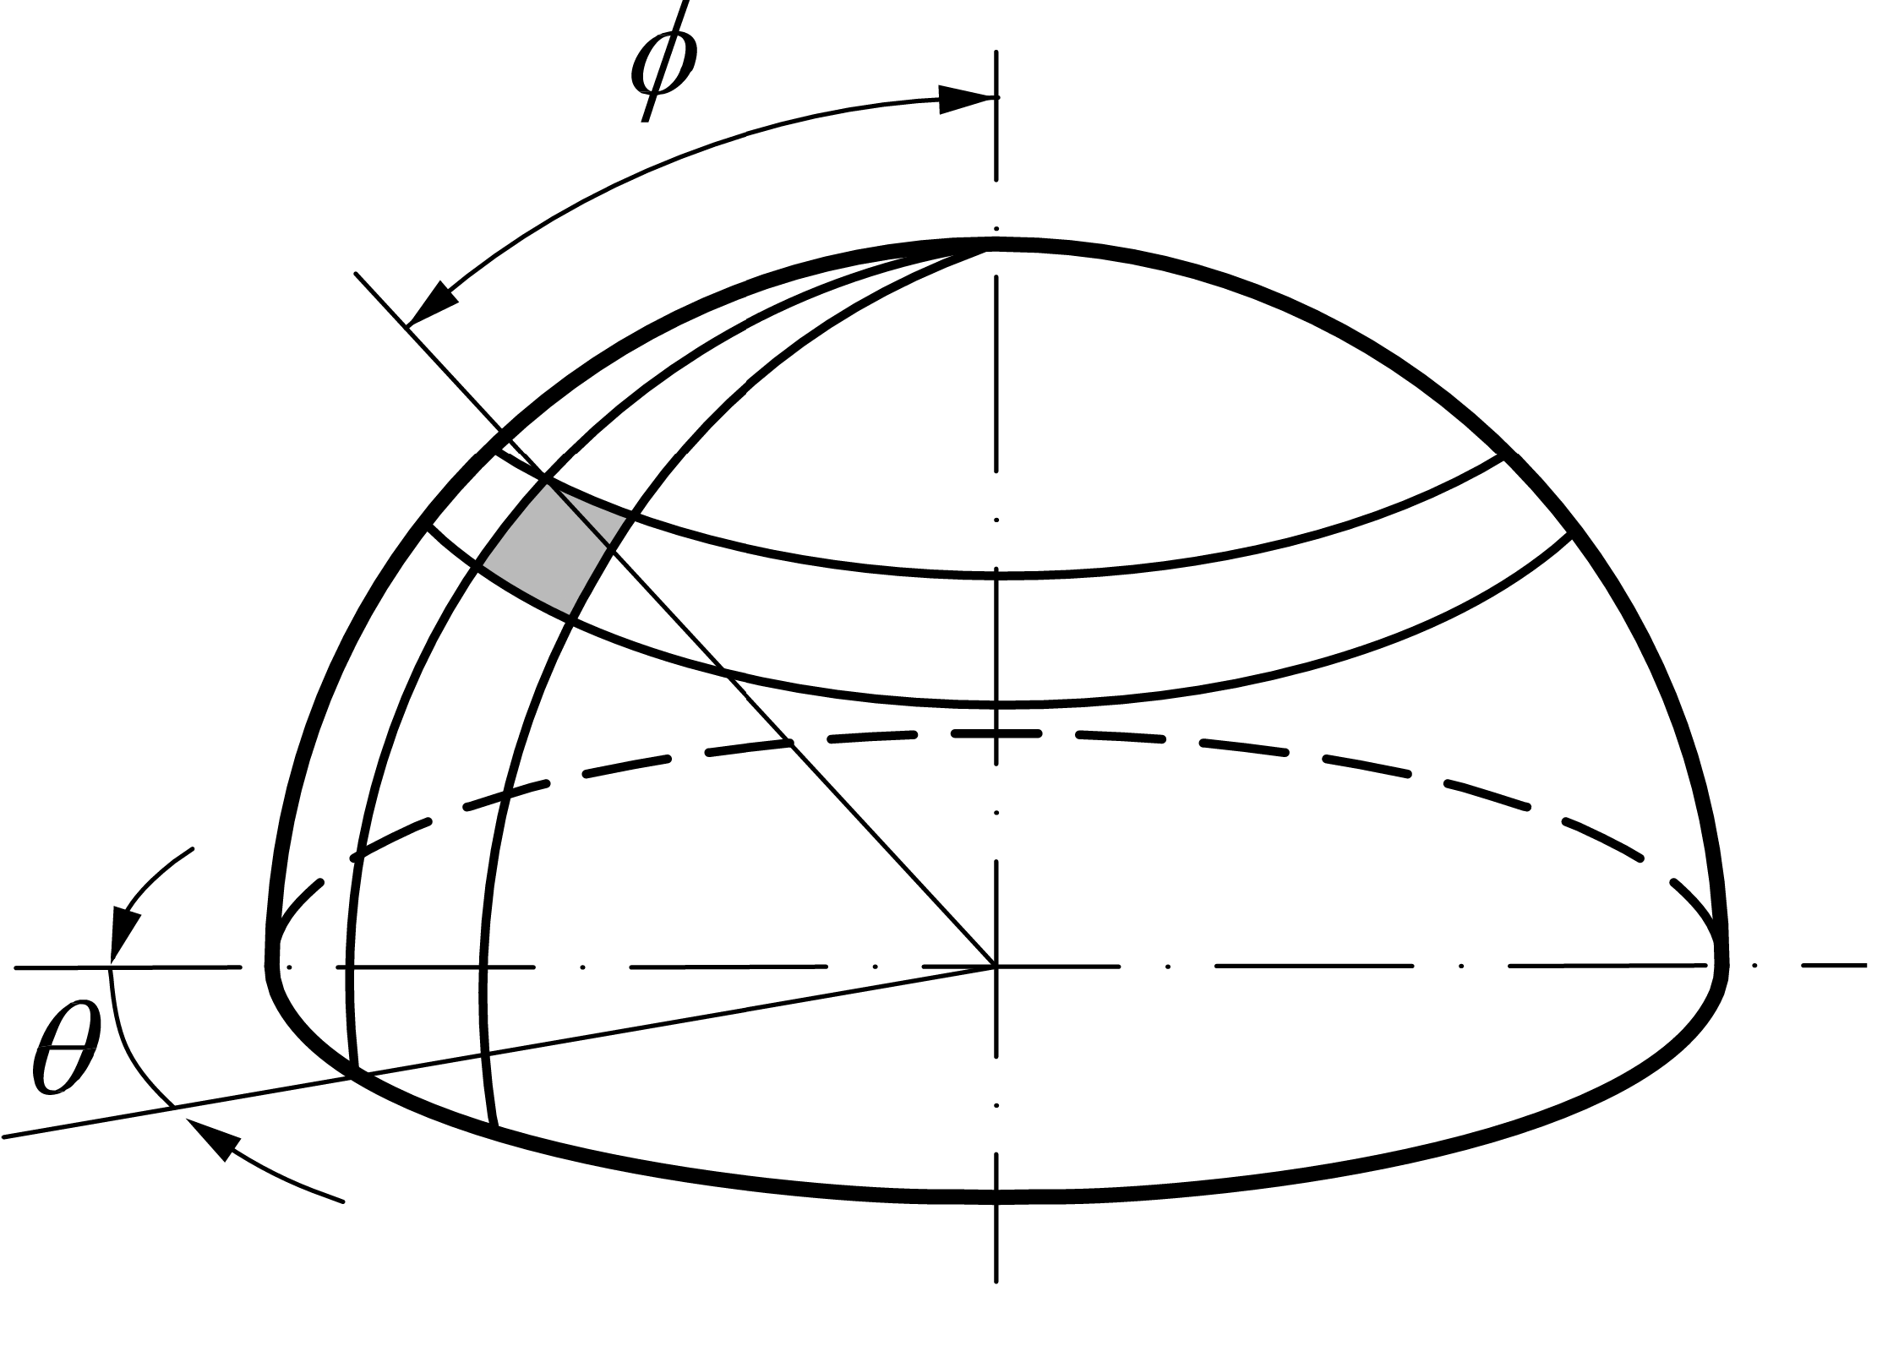
Shells of Revolution (Domes)
• Thin shells in the form of surfaces of revolutions serve primarily as roof structures. A surface of revolution is
obtained by the rotation of a plane curve about an axis lying in the plane of the curve. This curve is called
meridian and its plane the meridian plane.
• The meridian is an arc of a circle for spherical shells, and a straight segment for cylindrical and conical shells.
• The differential element used in the shell analysis is cut from the surface by two adjacent meridian planes and by
two adjacent parallel planes normal to the axis of rotation
2 / 53

Slide 4
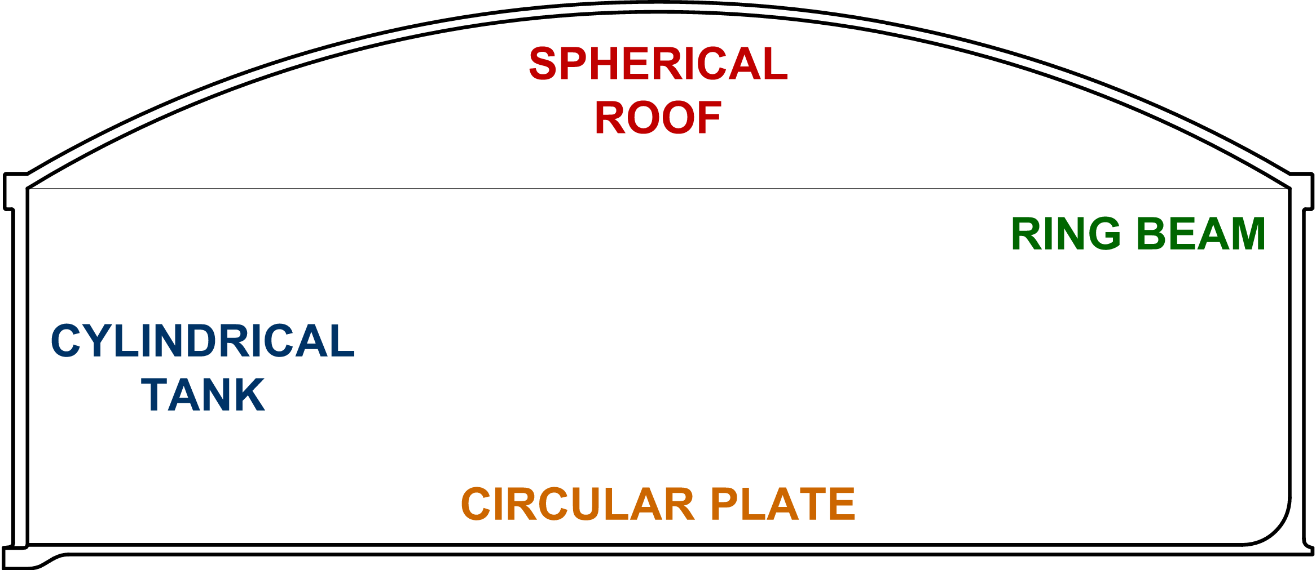
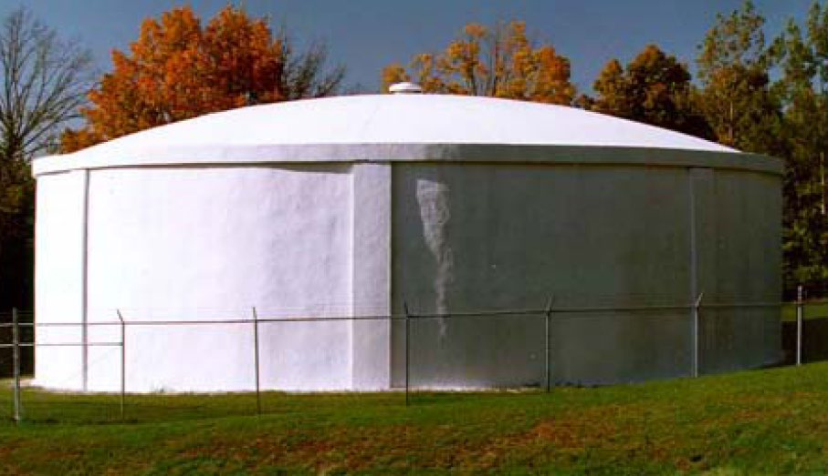
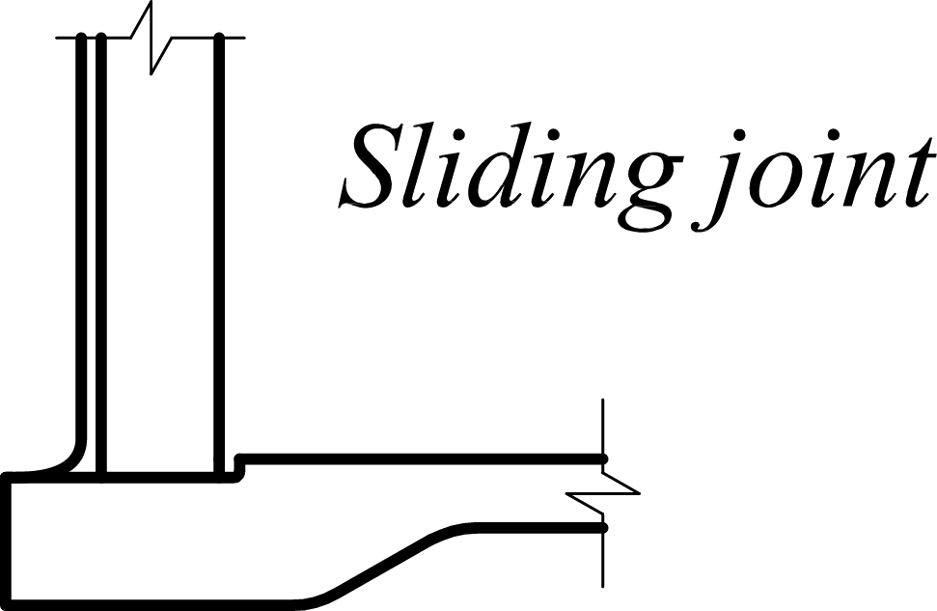
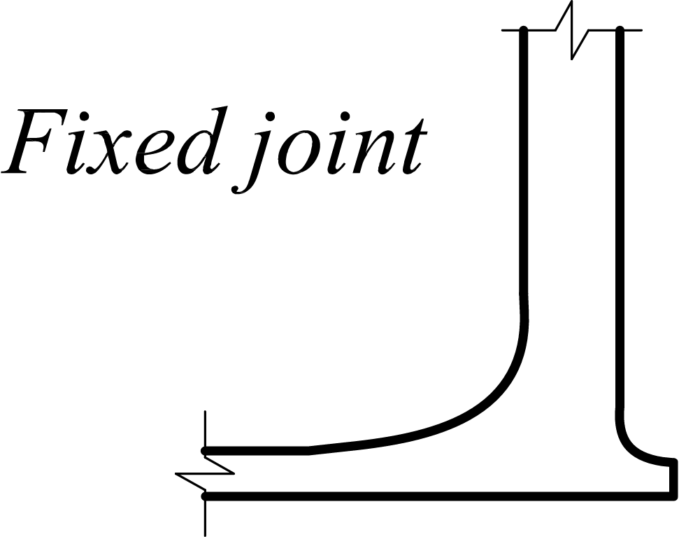
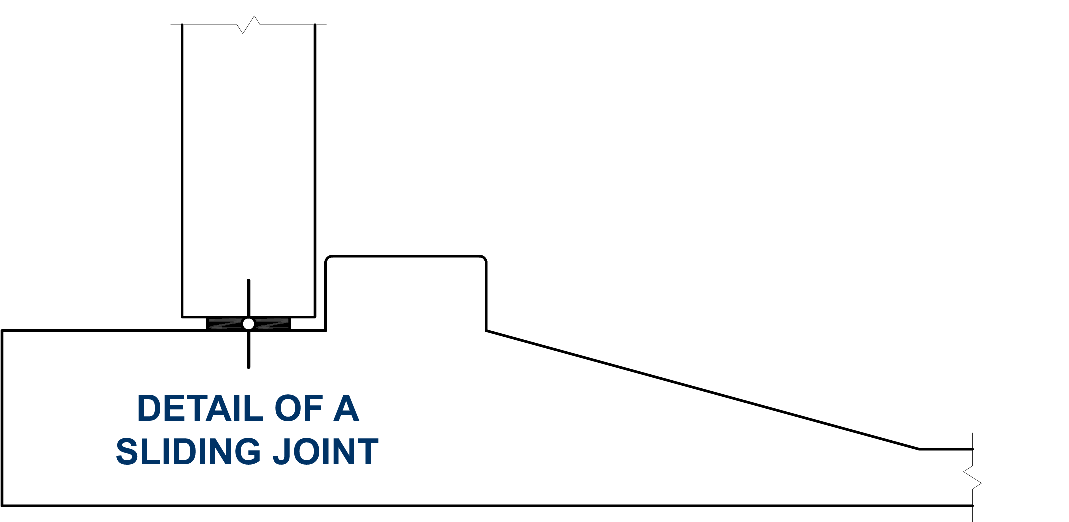
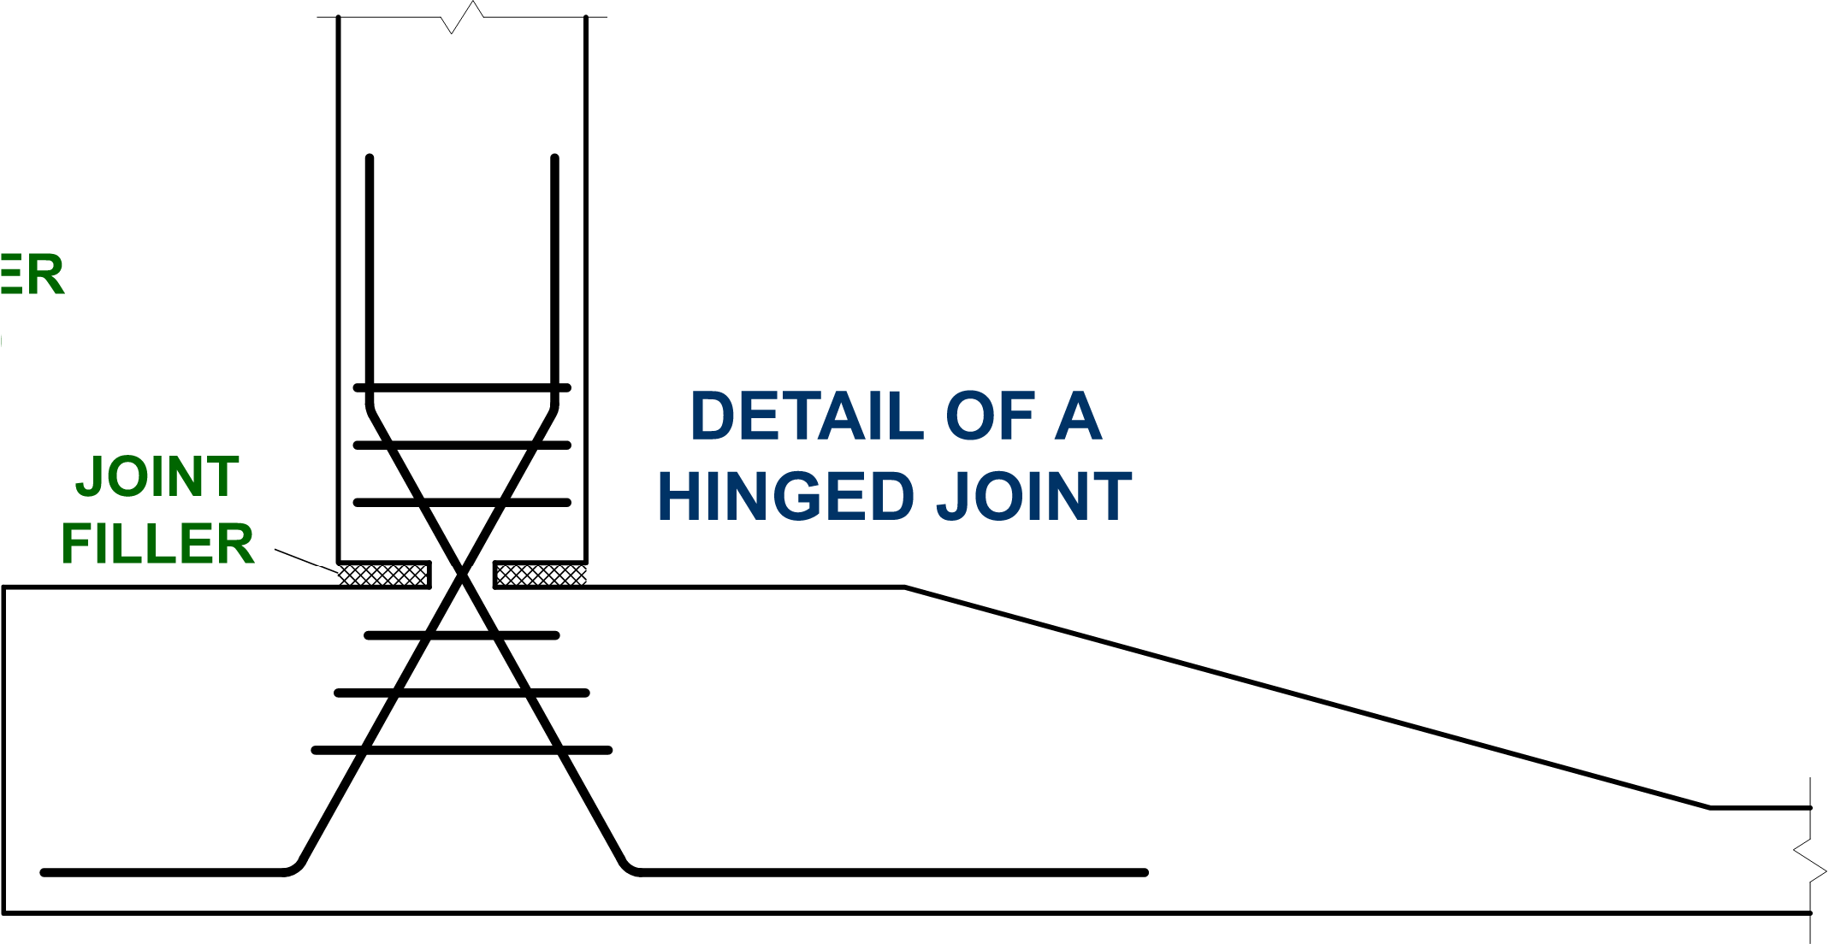
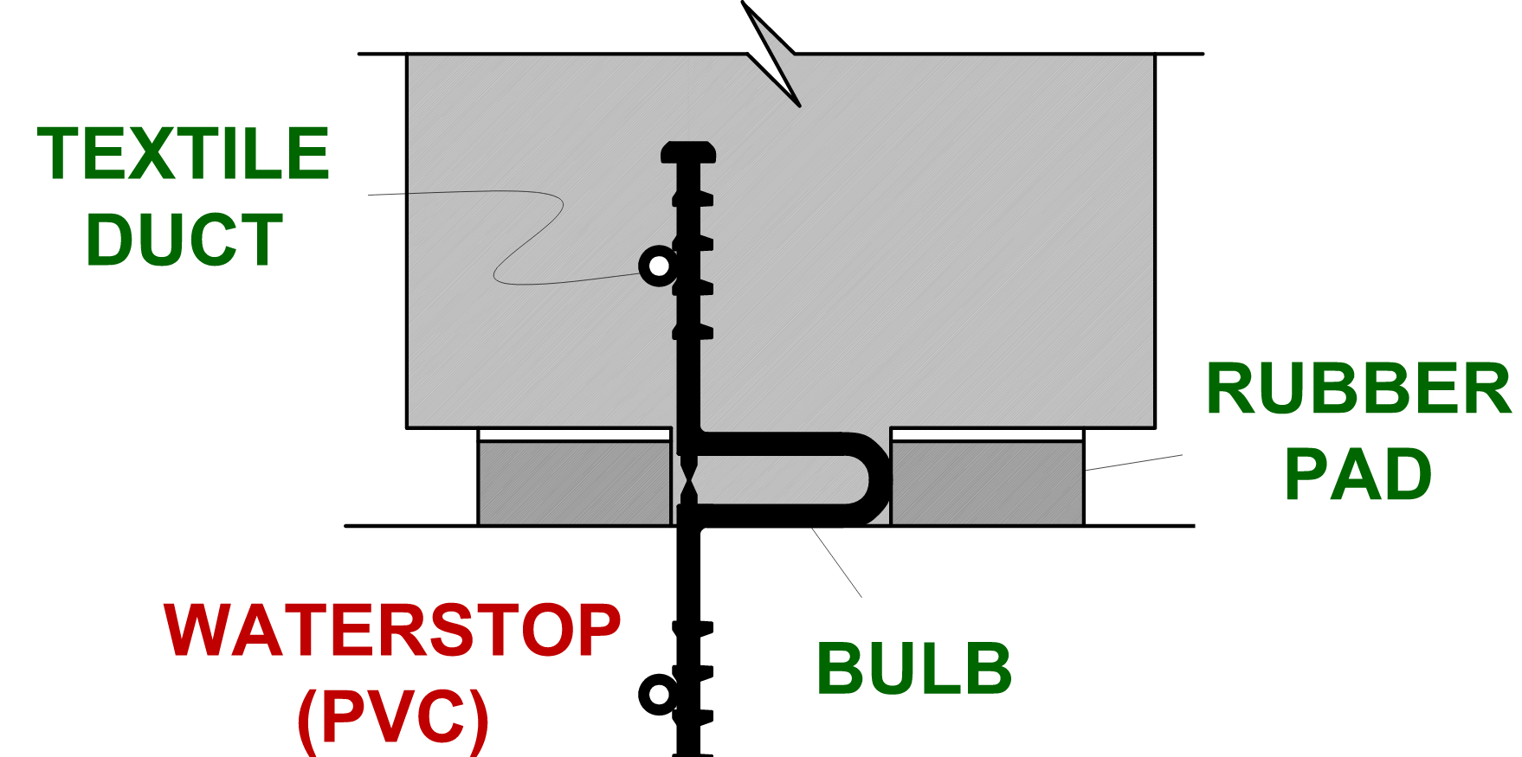
Cylindrical Tank with Spherical Roof
3 / 53

Slide 5
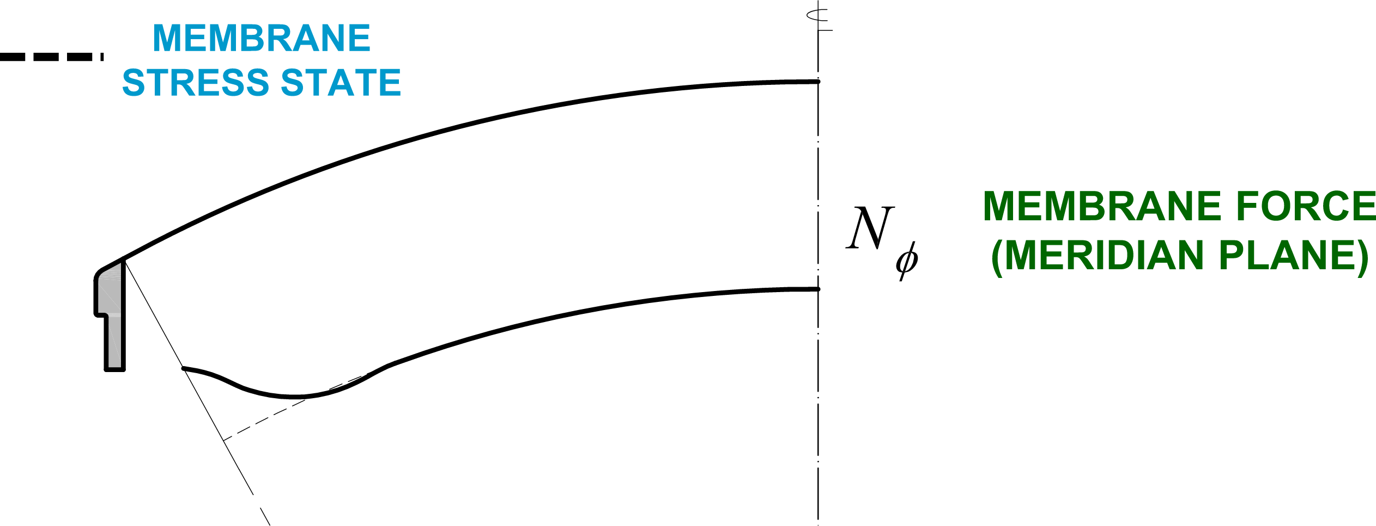
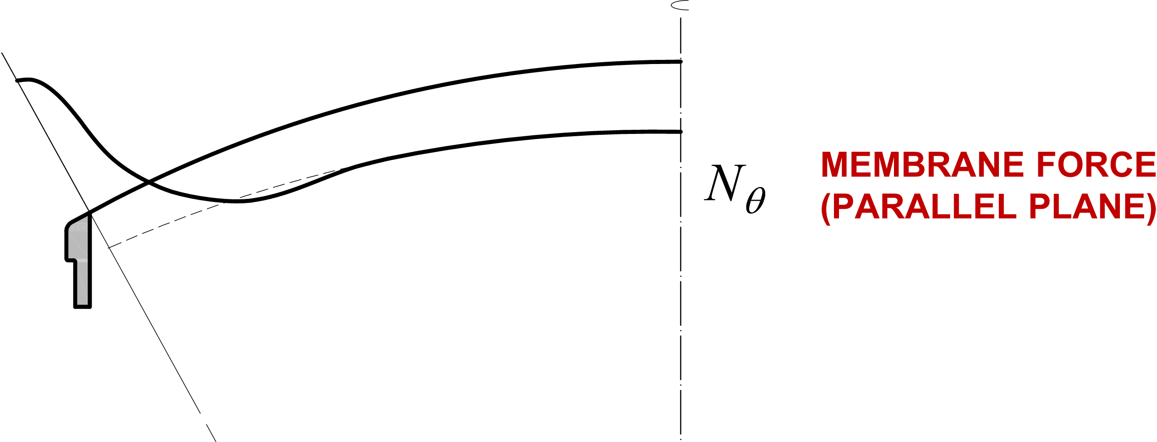
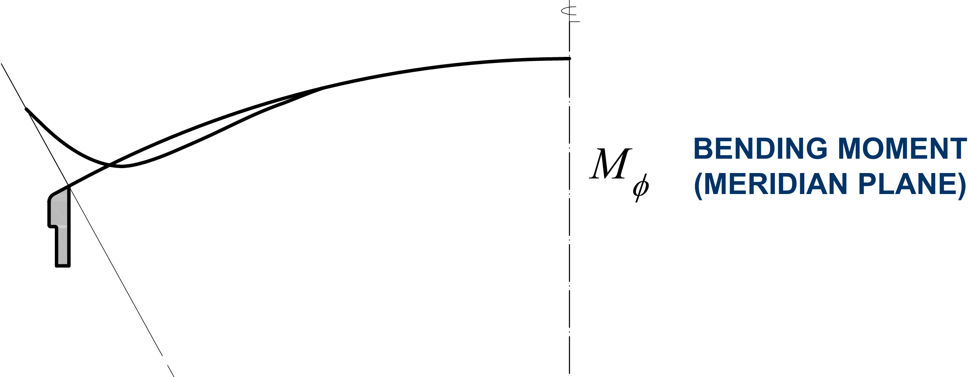
Cylindrical Tank with Spherical Roof
• Thin shells tend to sustain external
distributed loads by means of statically
determinate membrane (momentless) stress
states.
• This ideal bearing mechanism is “disturbed”
by the flexural stress states caused by
external forces or internal reactions acting at
the shell edges (edge disturbances).
• Therefore, the solutions given by the
membrane theory must, in many cases, be
supplemented by a solution from the
bending theory
• However, at suitable distance from the
disturbances (usually small) the stress state
may be considered as momentless and the
complete solution be found from the
membrane theory.
4 / 53

Slide 6
Membrane vs Flexural Stress States
It can be shown that a membrane stress state in thin shells corresponds to the minimum of strain energy stored by a shell during its
straining. The following conditions are necessary and sufficient for an existence of a momentless state of stress:
1. The boundaries of the shell are free from transverse shear forces and moments. Loads applied to the shell boundaries must lie in
planes that are tangent to the midsurface of the shell.
2. The normal displacements and rotations at the shell edges are unconstrained: that is, the edges can displace freely in the
direction of the normal to the midsurface.
3. The shell must have smoothly varying and continuous bounding surfaces, or midsurface and thickness continuous functions of
the coordinates.
4. The components of the surface and edge loads must be also smooth and continuous functions of the coordinates.
If these conditions are violated, fully or partially, flexural stresses occur and the solutions given by the membrane theory must be
supplemented by a solution of the equations of the bending momeht theory in those parts where bending proves to be important.
5 / 53

Slide 7
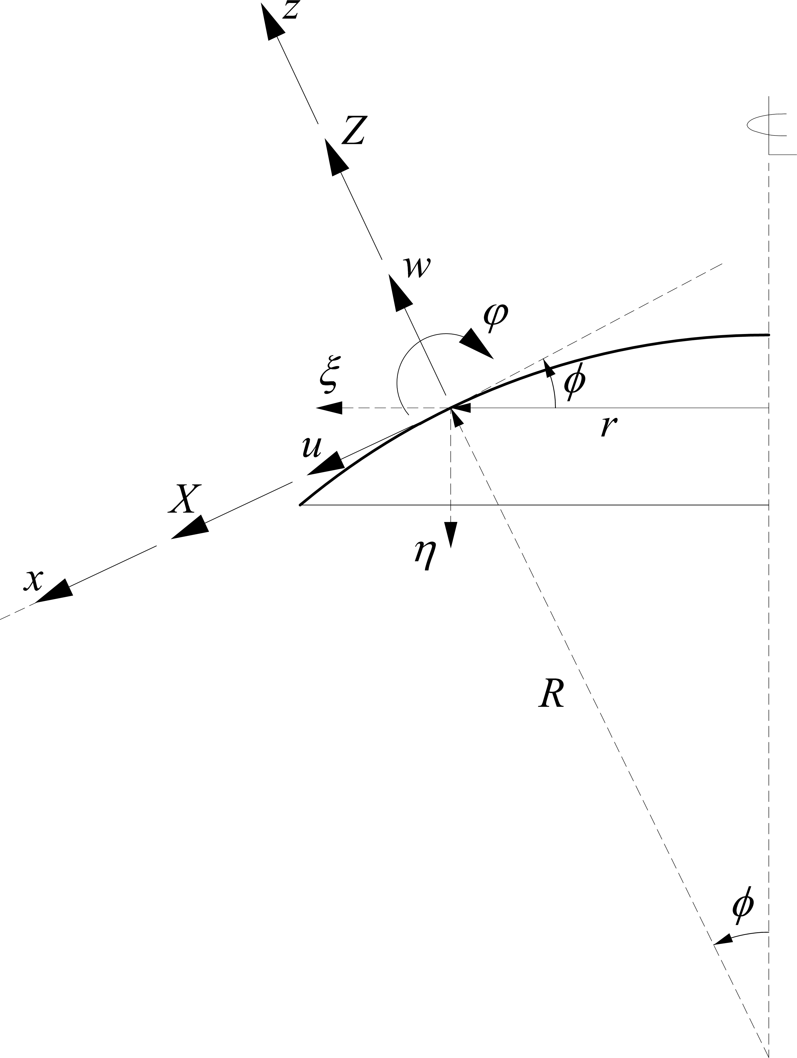
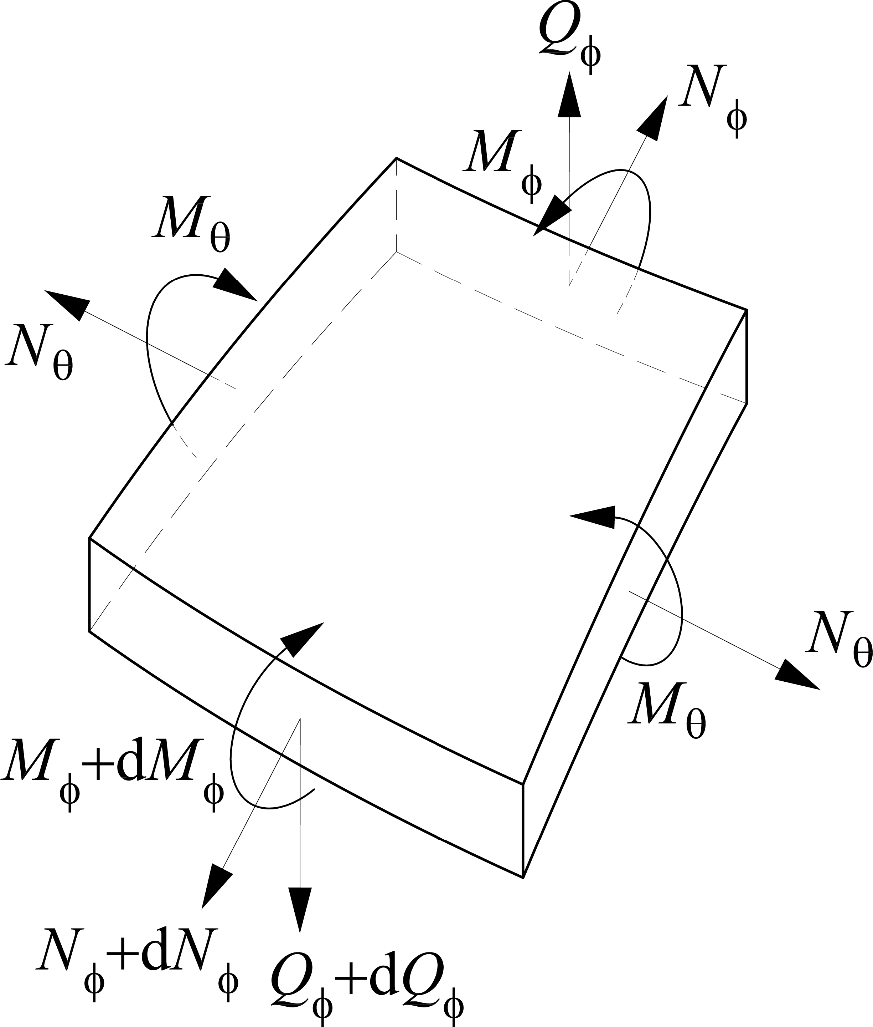
Rotationally Symmetric Spherical Shells
External loads
Internal stress resultants
Displacements
6 / 53

Slide 8
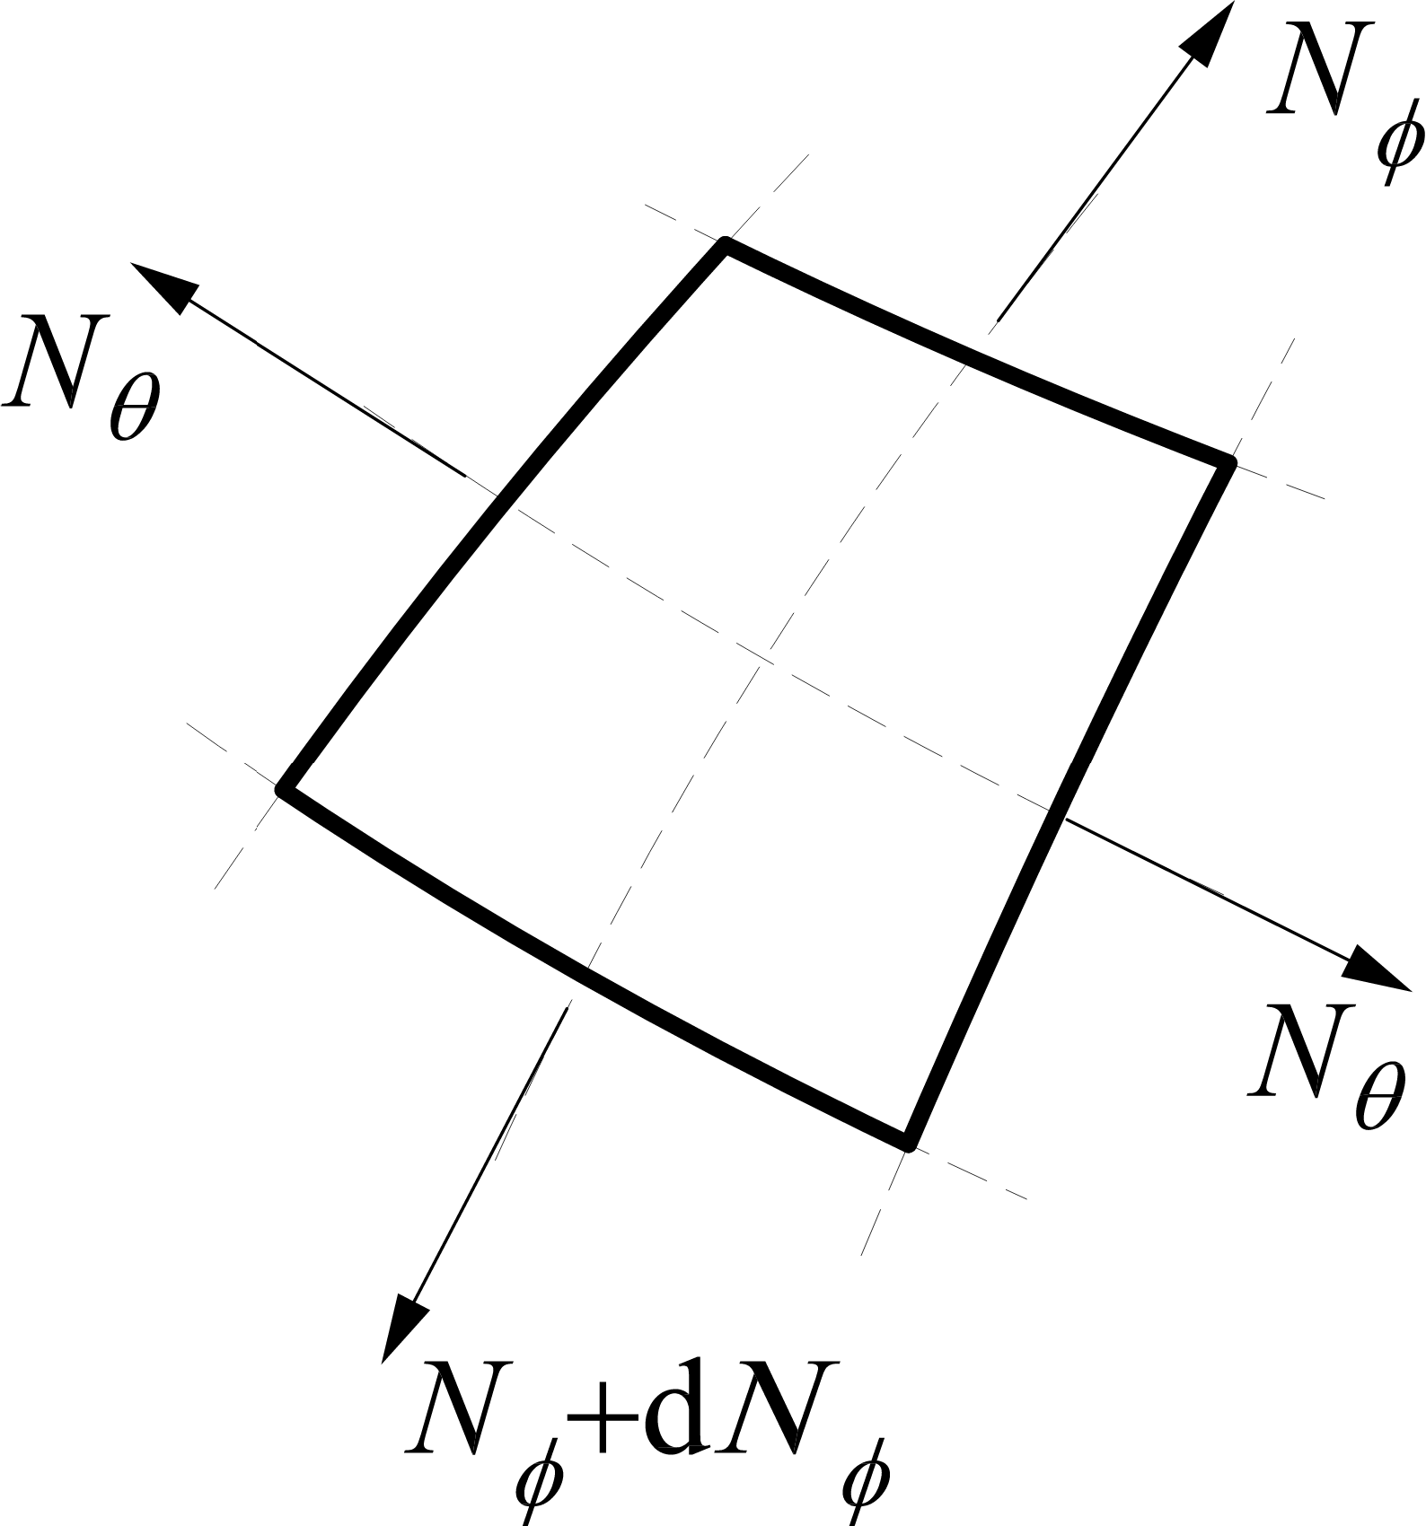
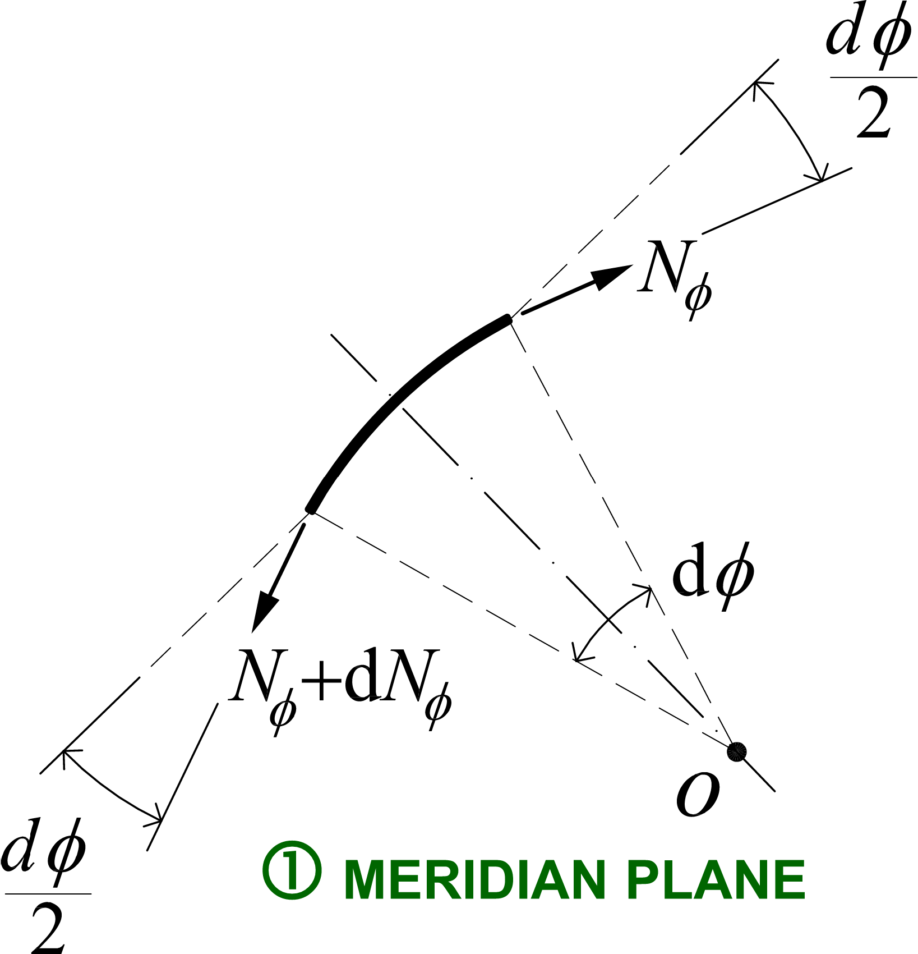
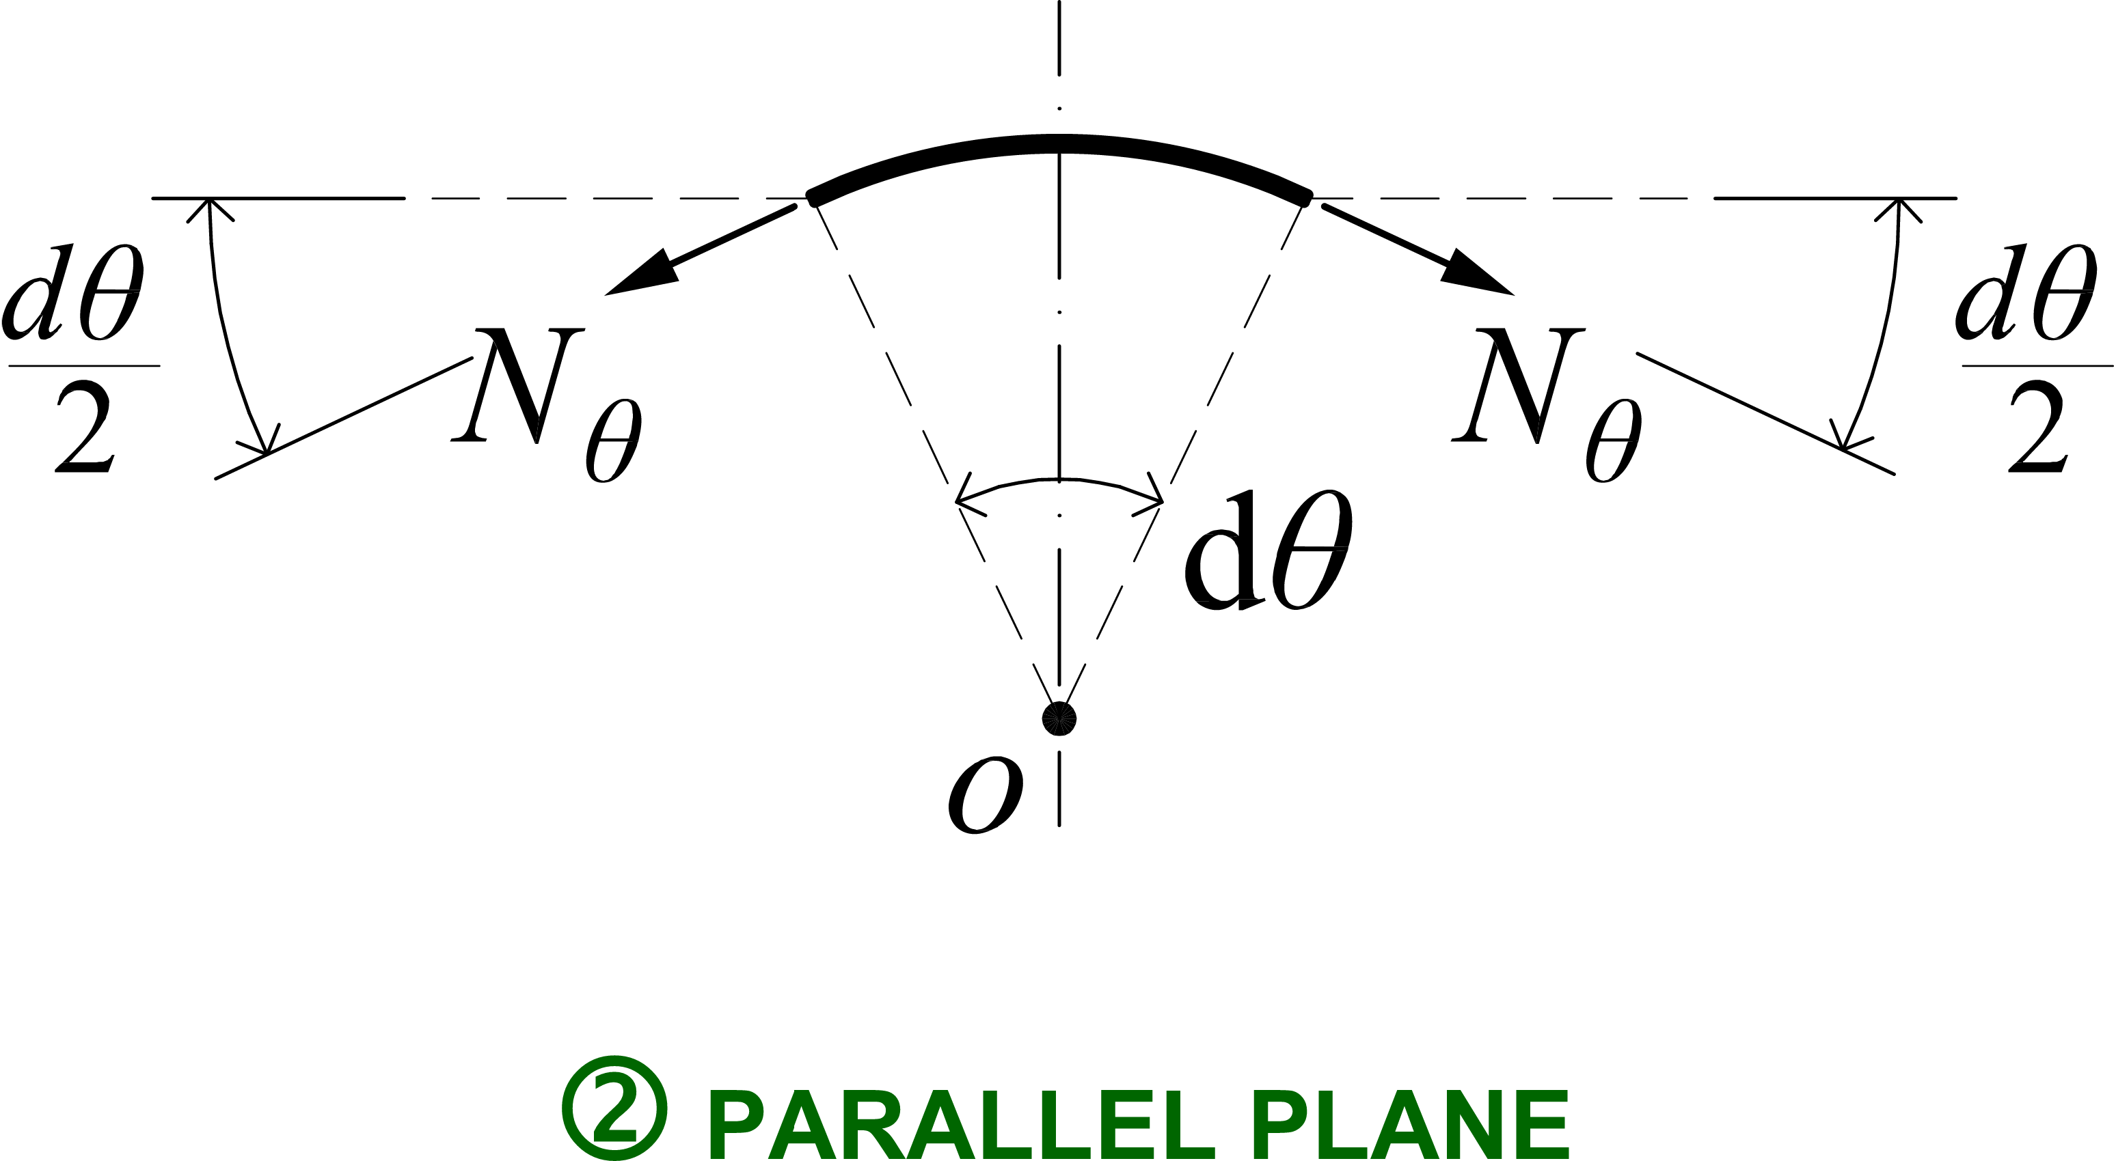
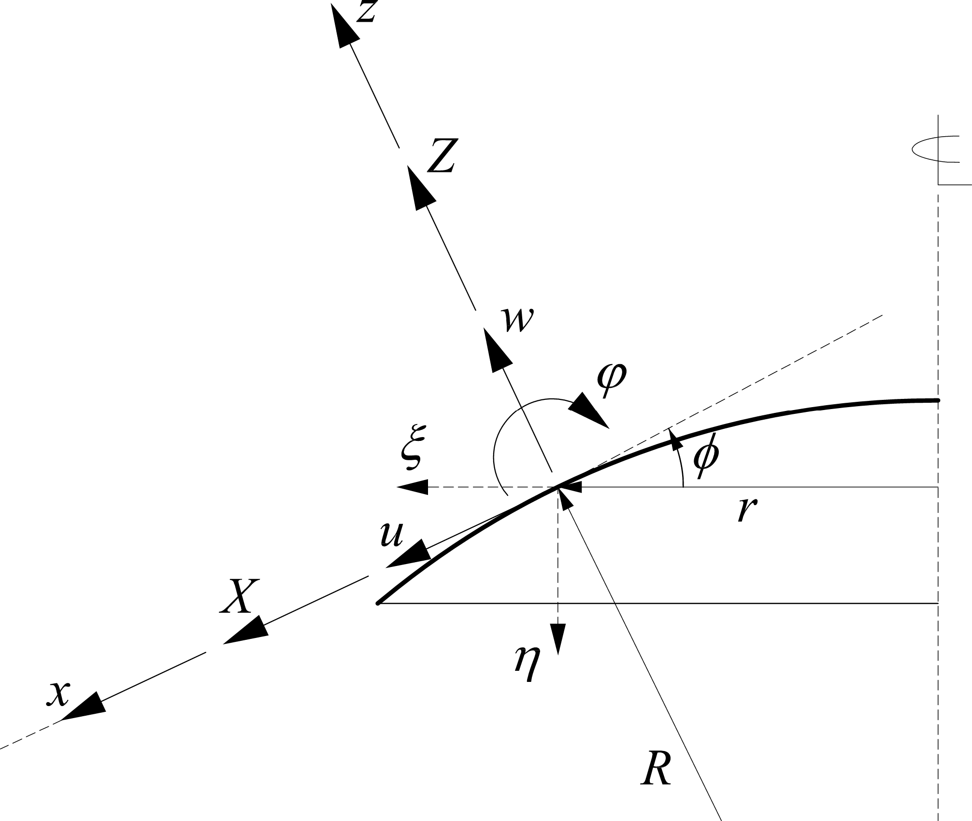
Membrane Theory: Local Equilibrium
𝑟 = 𝑅 sin Φ ⇒ 𝑁_{Φ} + 𝑁 = 𝑍𝑅
Θ
7 / 53

Slide 9
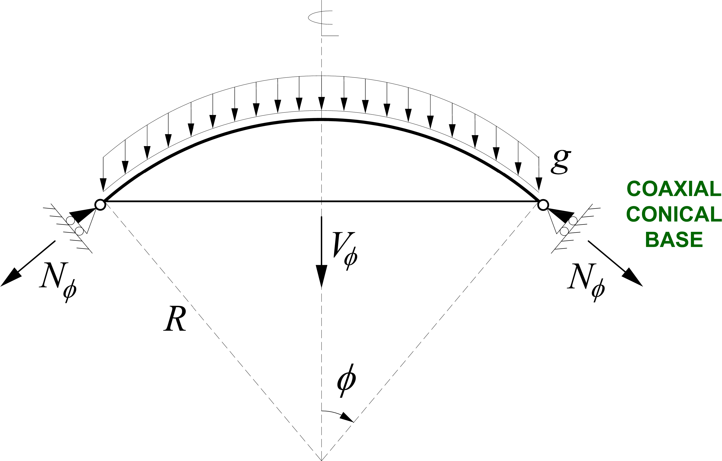
Membrane Theory: Global Equilibrium
8 / 53

Slide 10

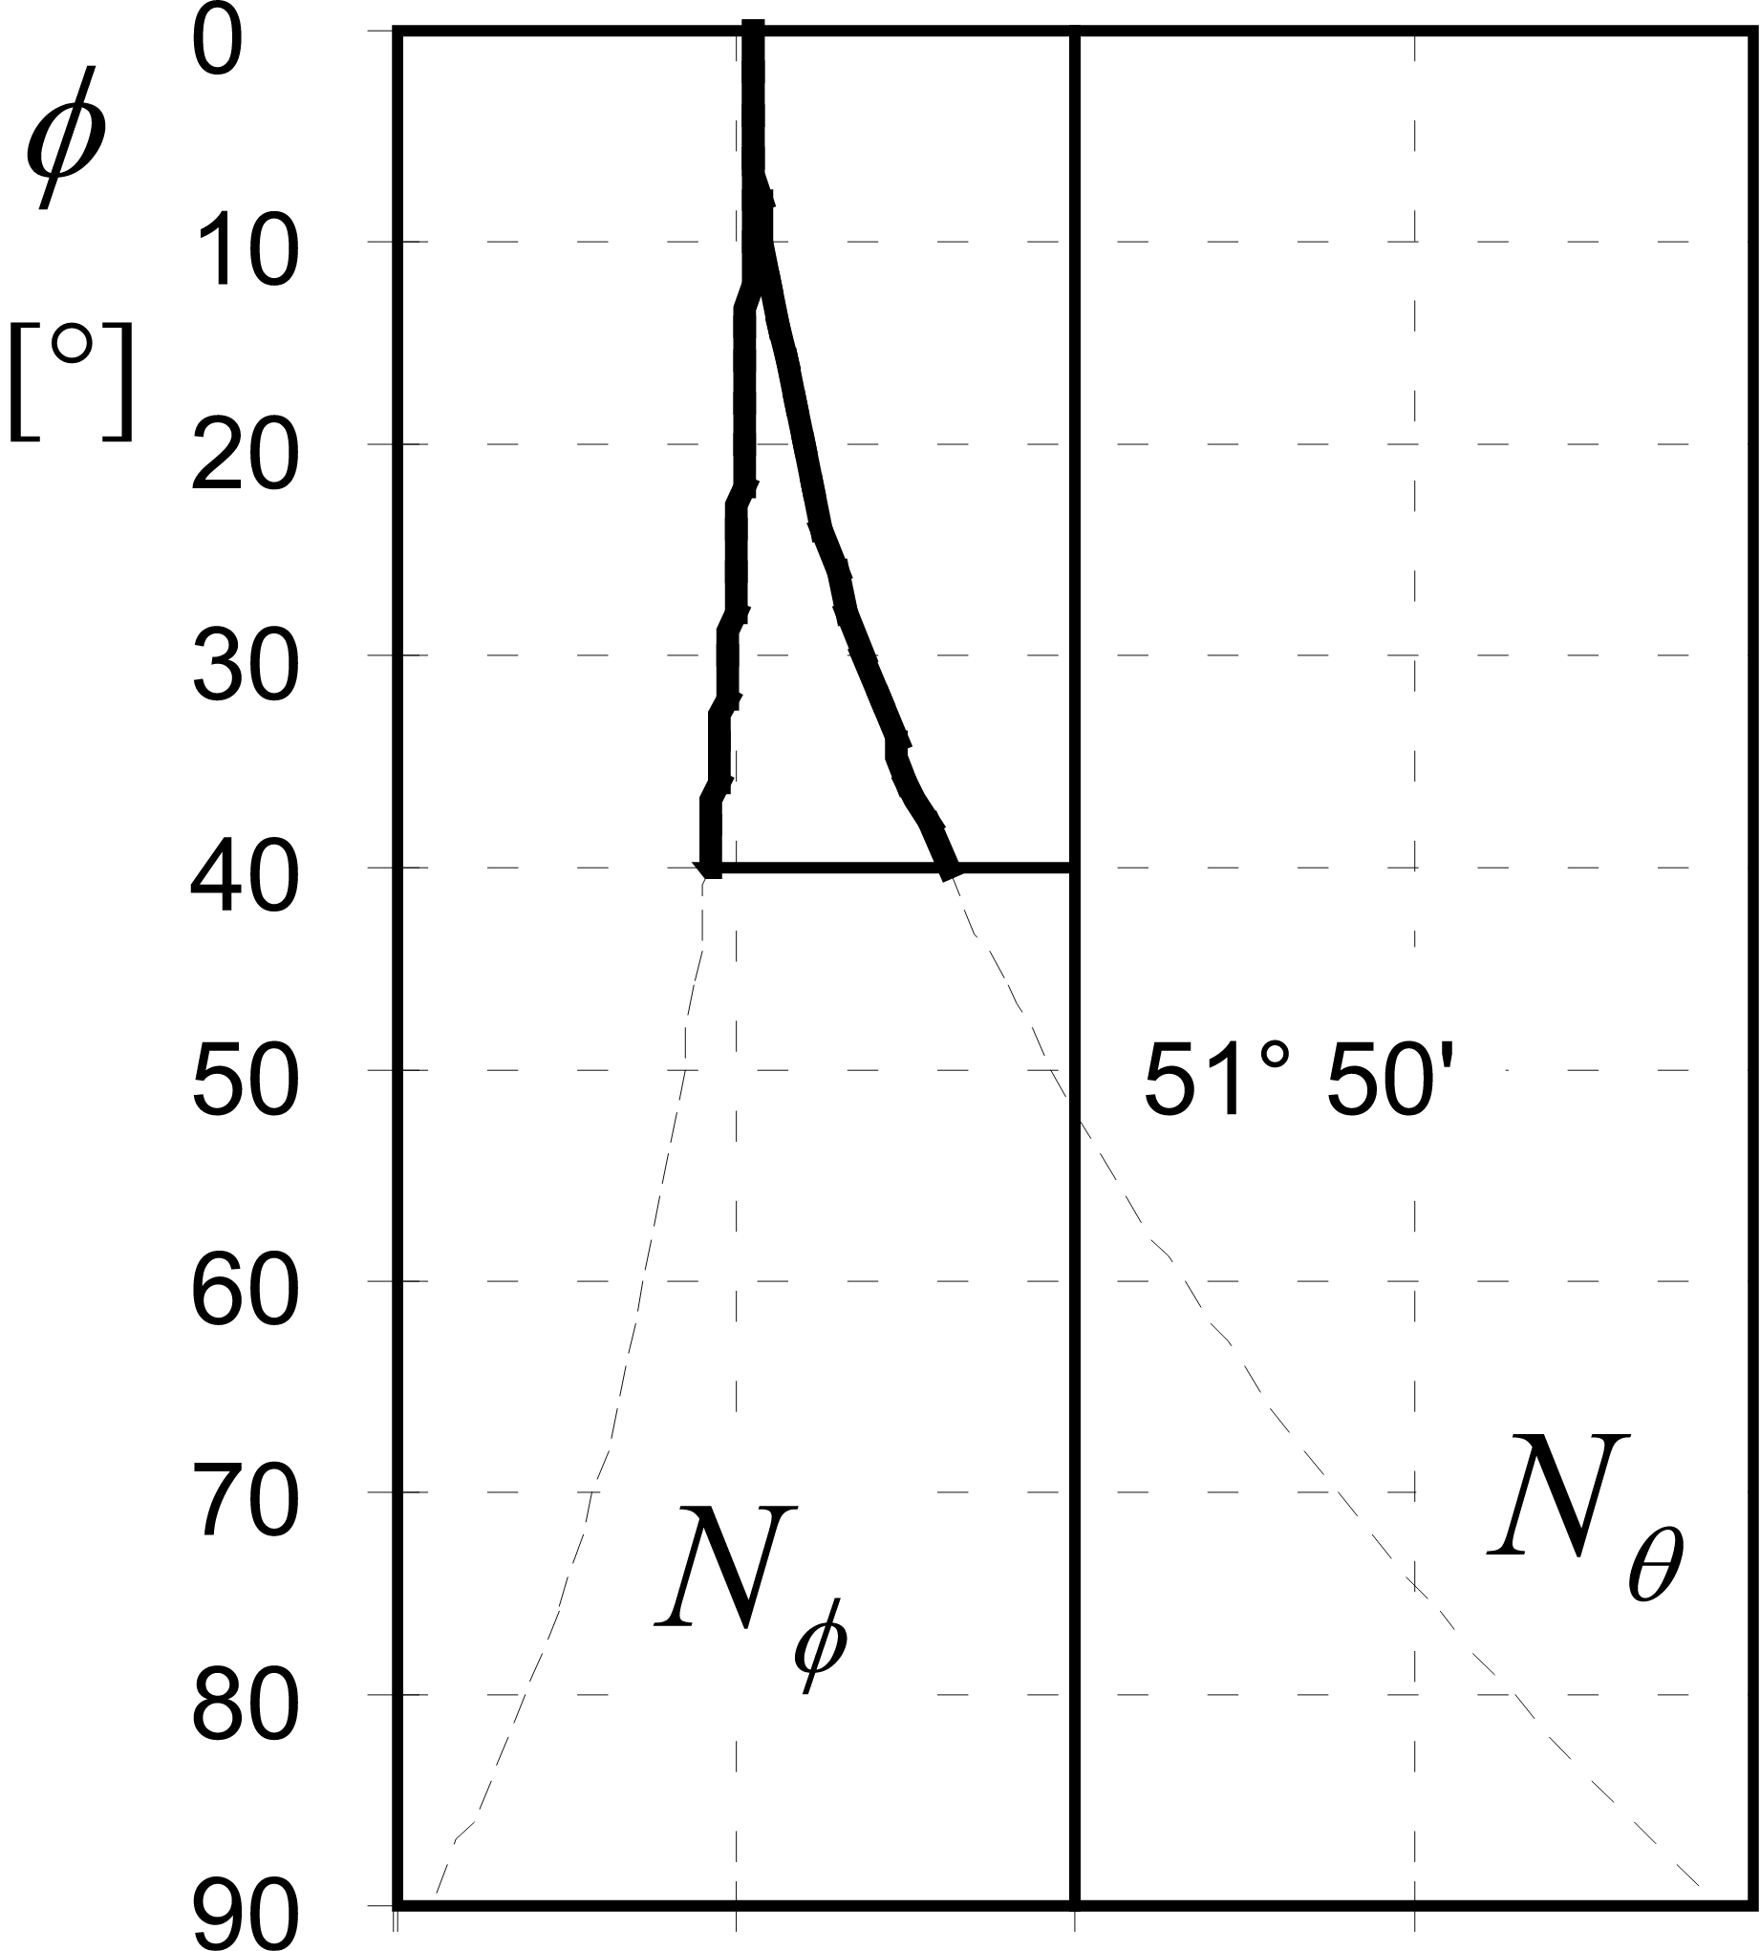
Membrane Stresses: Self-Weight
9 / 53

Slide 11
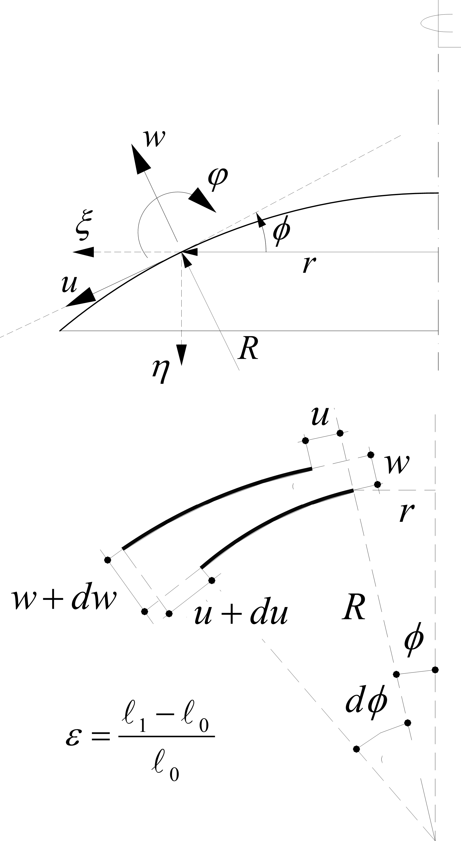
Membrane Theory: Compatibility (1/3)
⇒
⇒
⇒
10 / 53

Slide 12
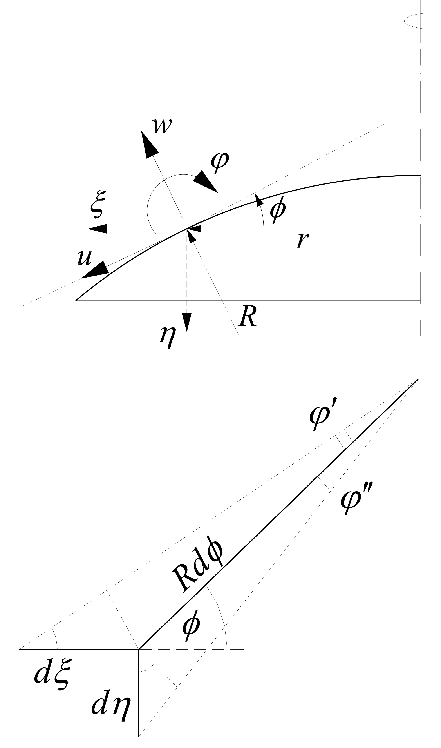
Membrane Theory: Compatibility (2/3)
⇒
⇒
⇒
11 / 53

Slide 13

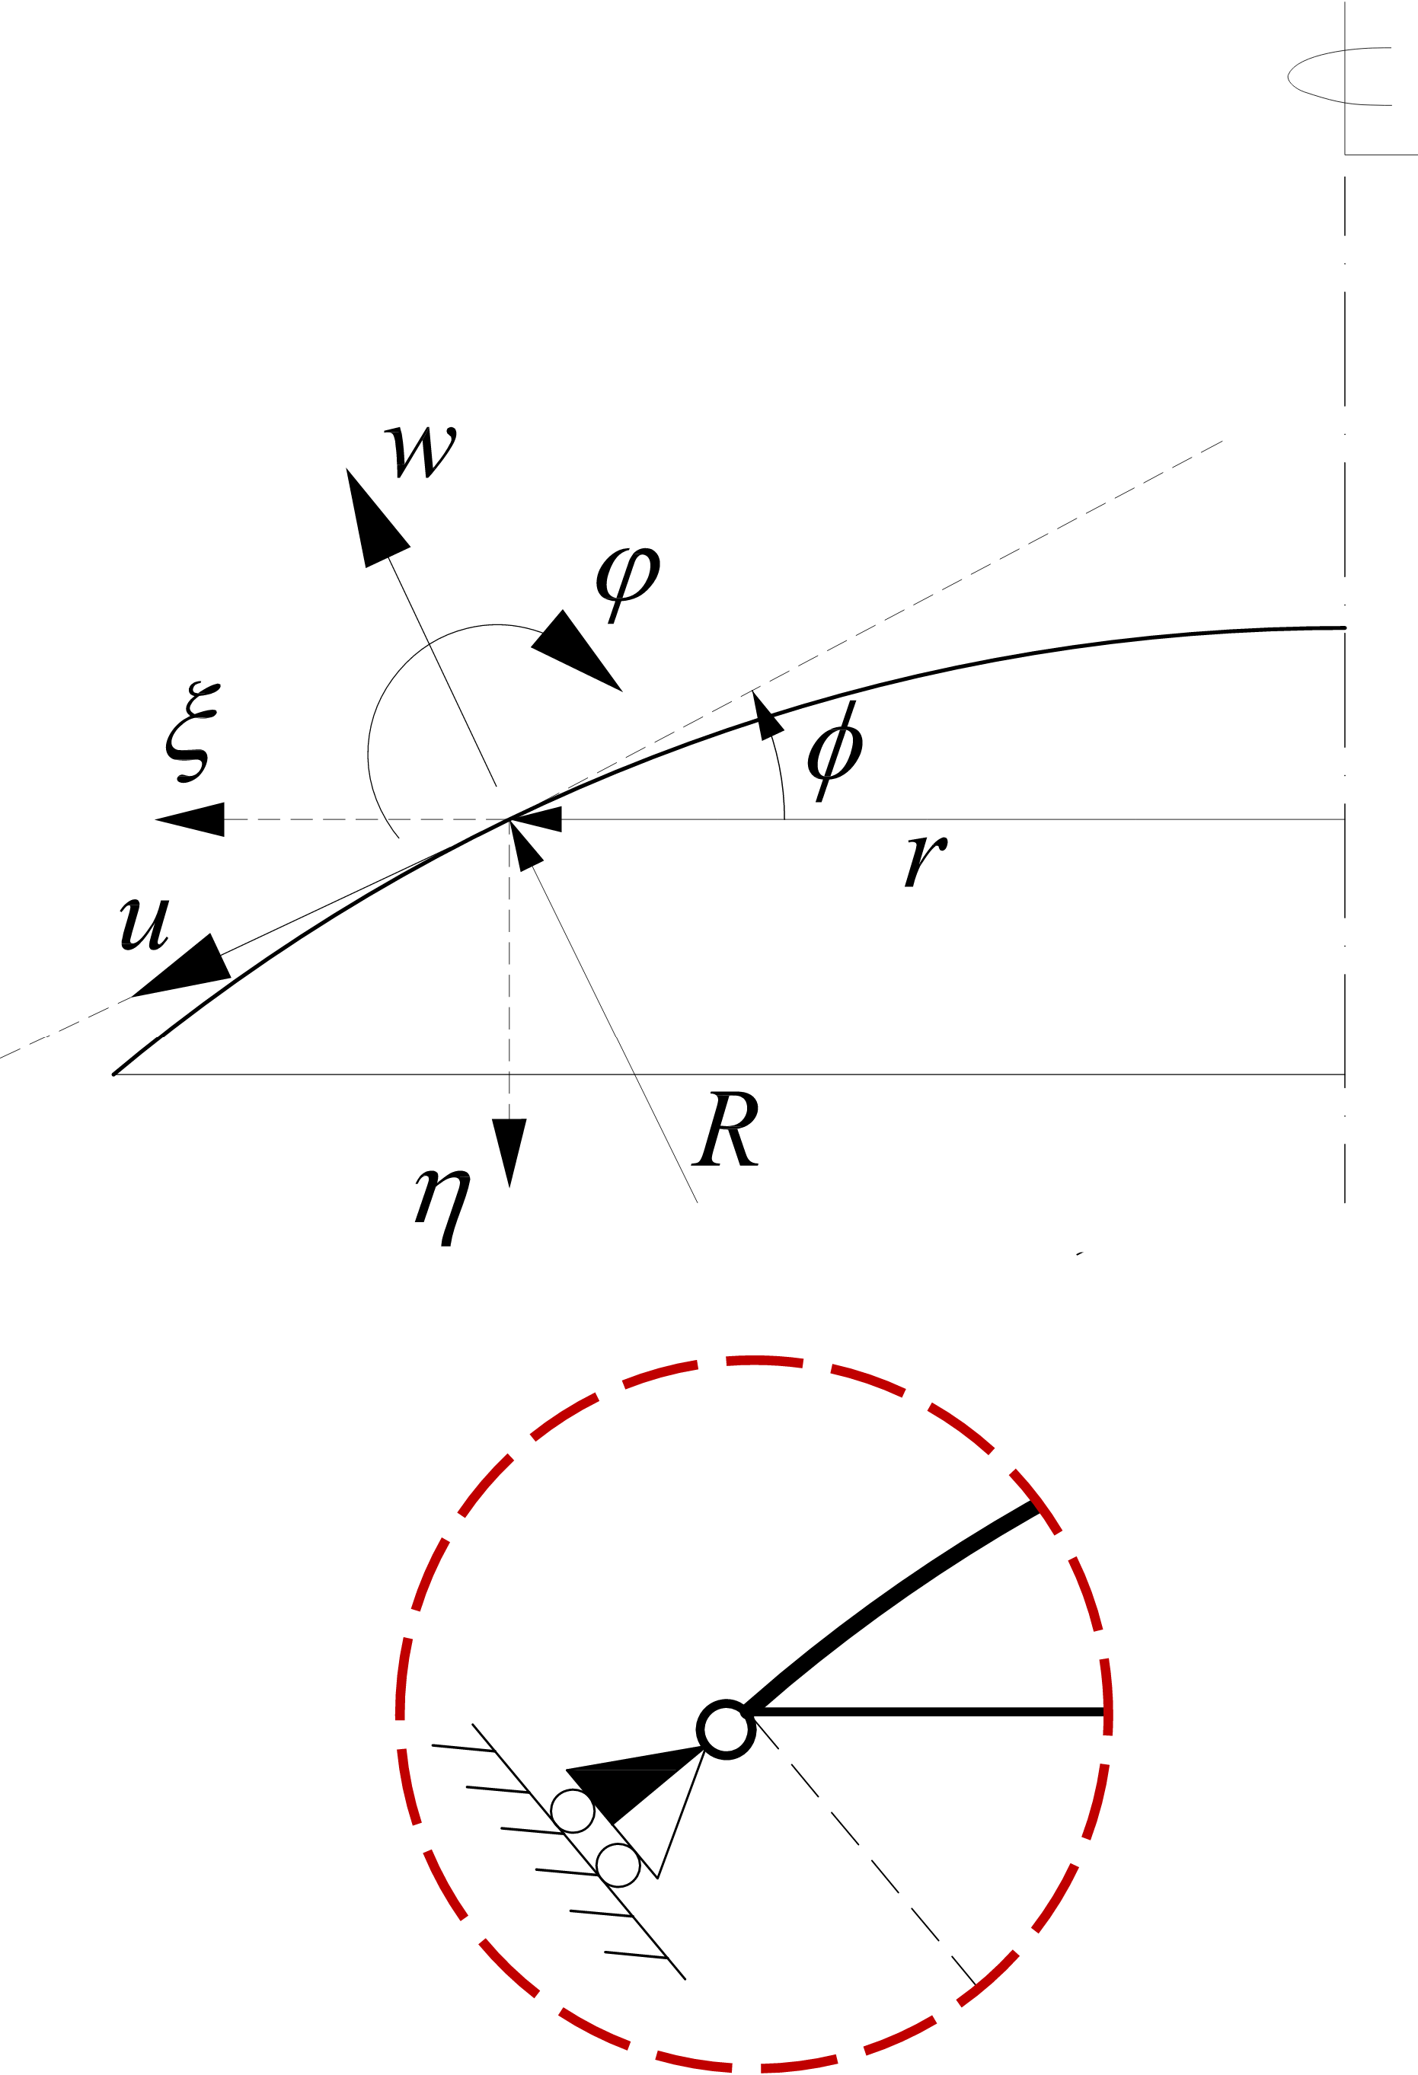
Membrane Theory: Compatibility (3/3)
Info
The radial
displacement 𝜉 and the
rotation 𝜙 can be
computed
independently on the
integral term. The
integration constant 𝐶
depends on the
boundary conditions
and represents a rigid
body motion 𝜂 = 𝐶
along the axis of
symmetry.
⇒
12 / 53

Slide 14
Displacements: Self-Weight (1/2)
⇒
13 / 53

Slide 15
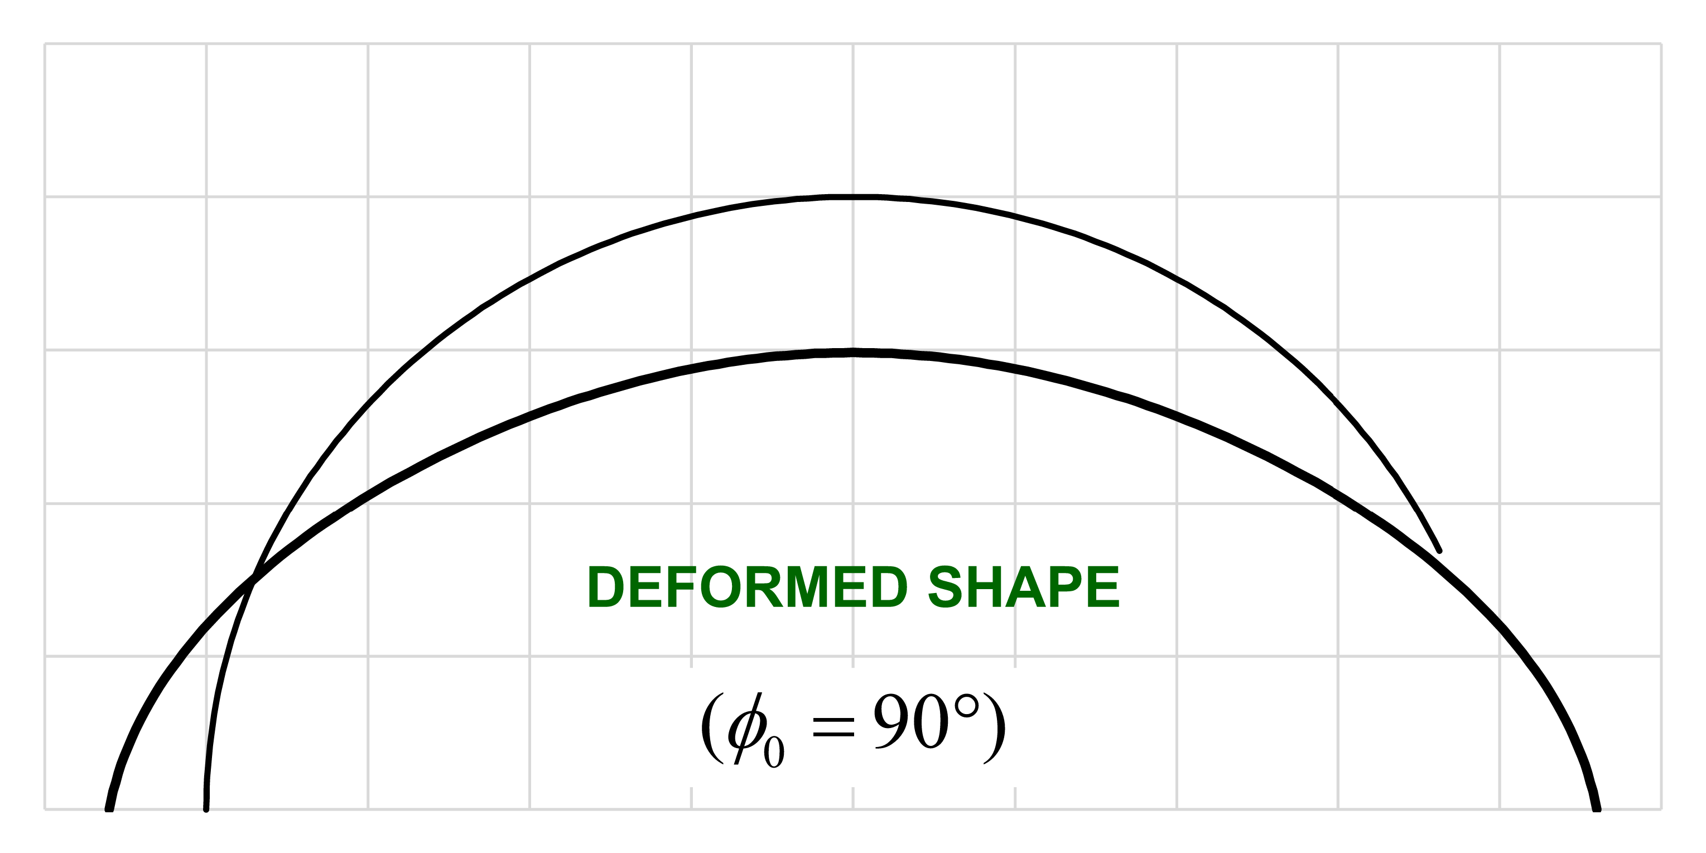
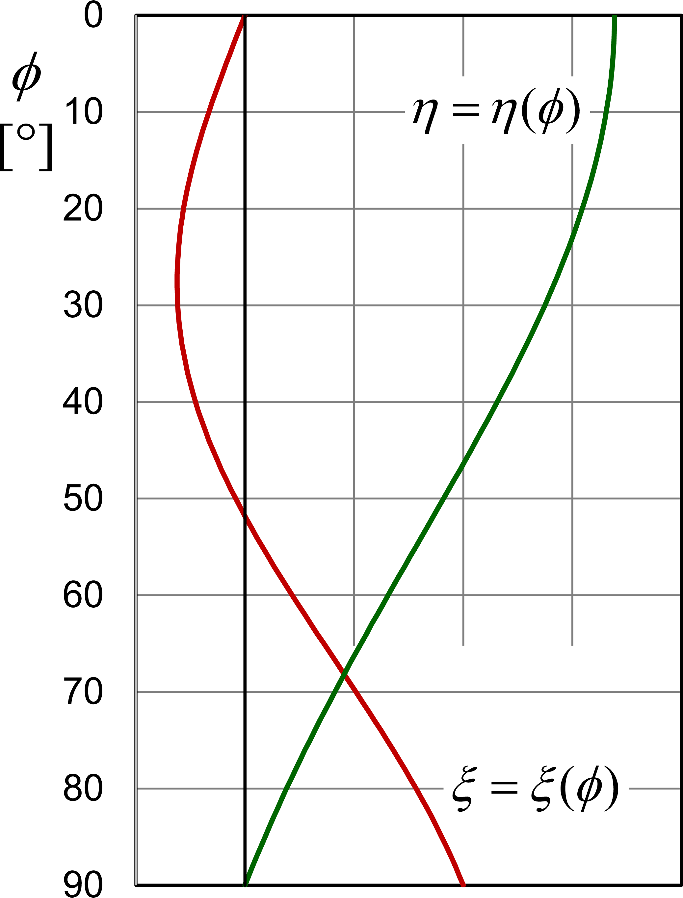
Displacements: Self-Weight (2/2)
14 / 53

Slide 16
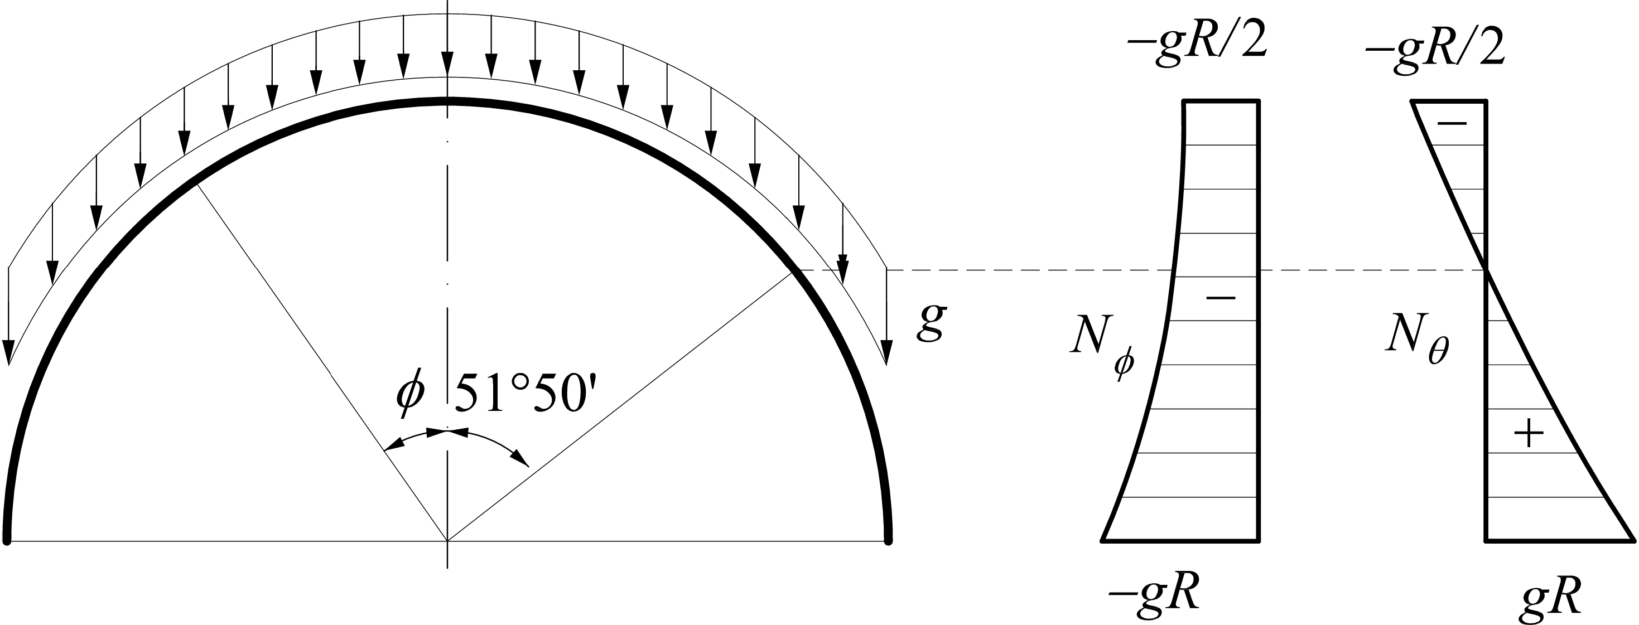
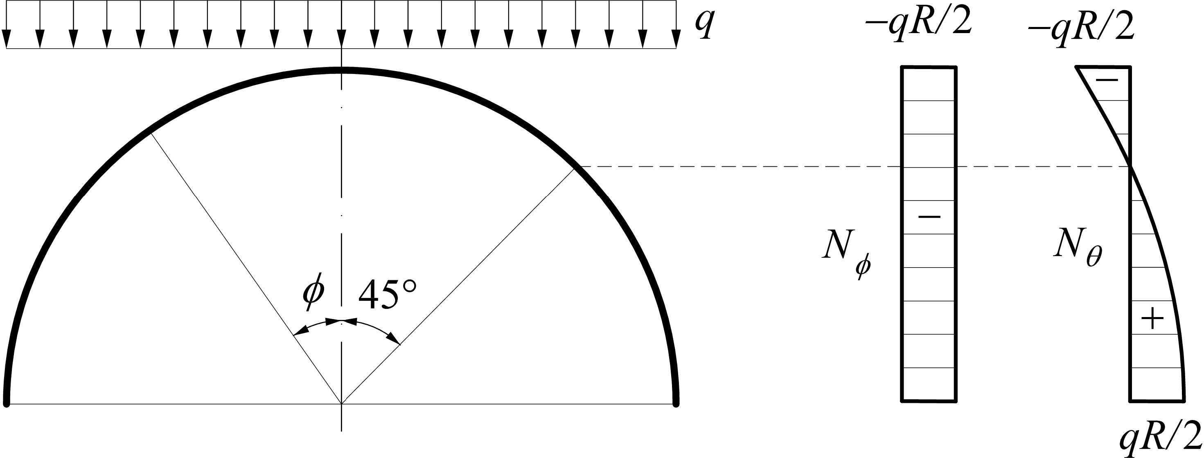
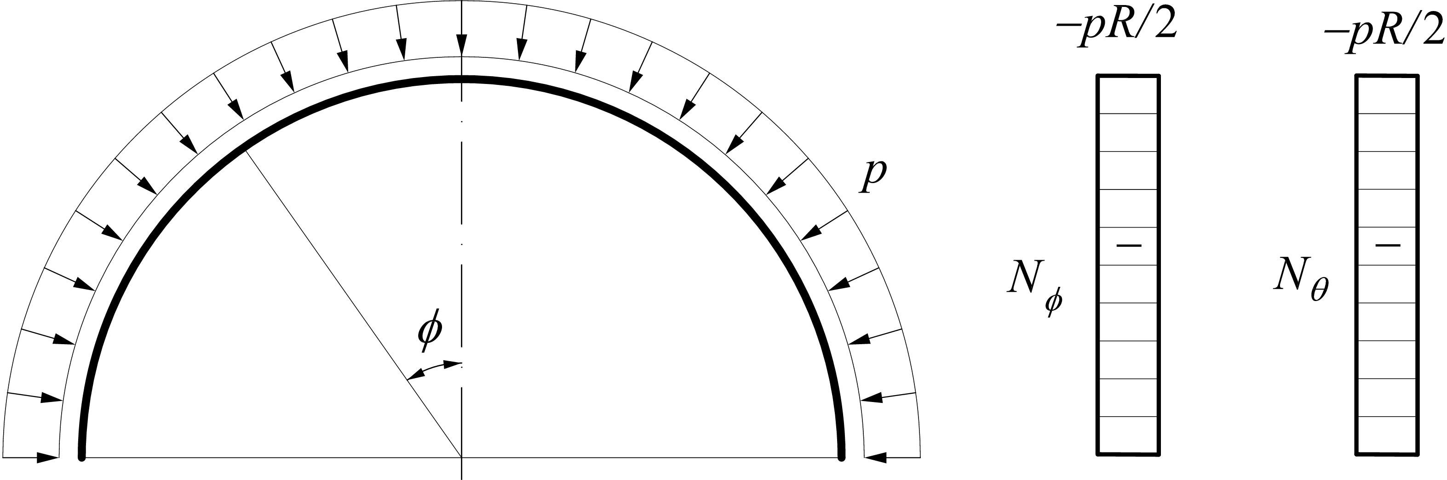
Membrane Theory: Stresses
Dead load
Snow load
Pressure
load
15 / 53

Slide 17
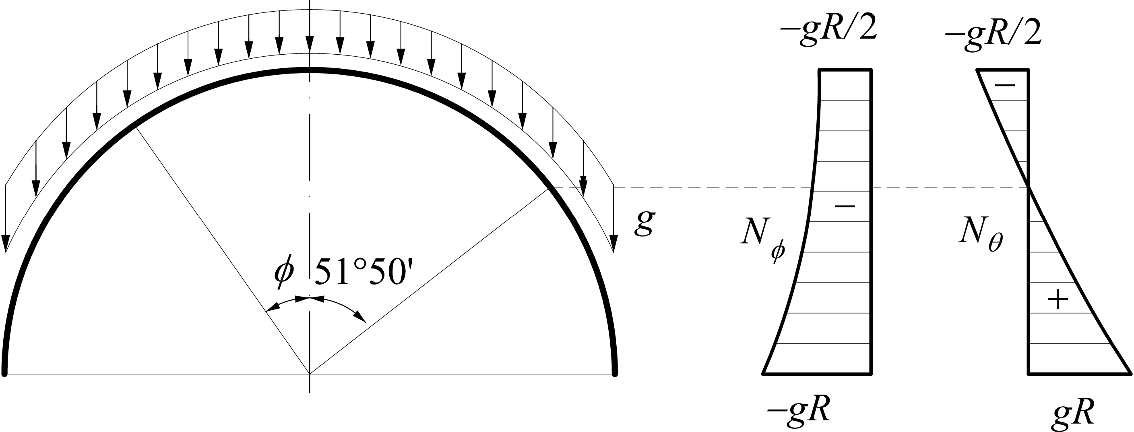
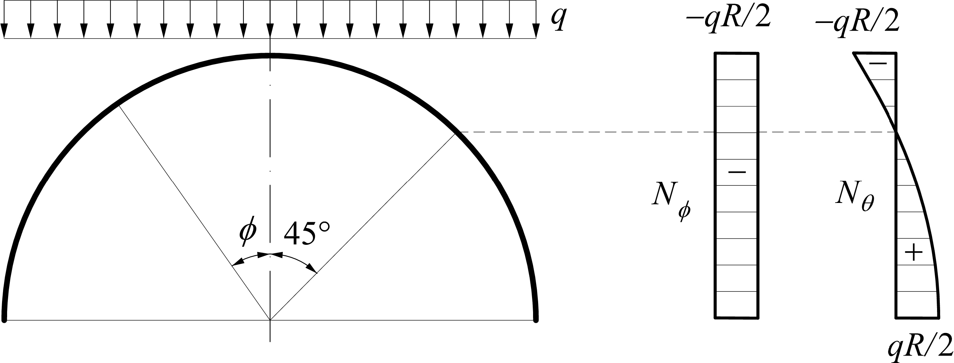
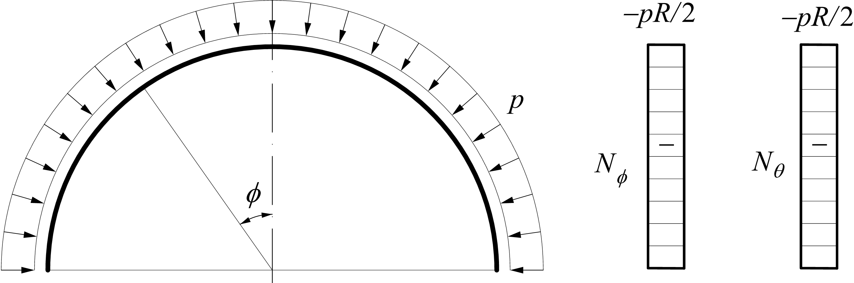
Membrane Theory: Displacements
Dead load
Note: The displacements components ξ and ϕ do not depend on the shell thickness h,
but are related to the specific weight
.
Snow load
Pressure
load
16 / 53

Slide 18
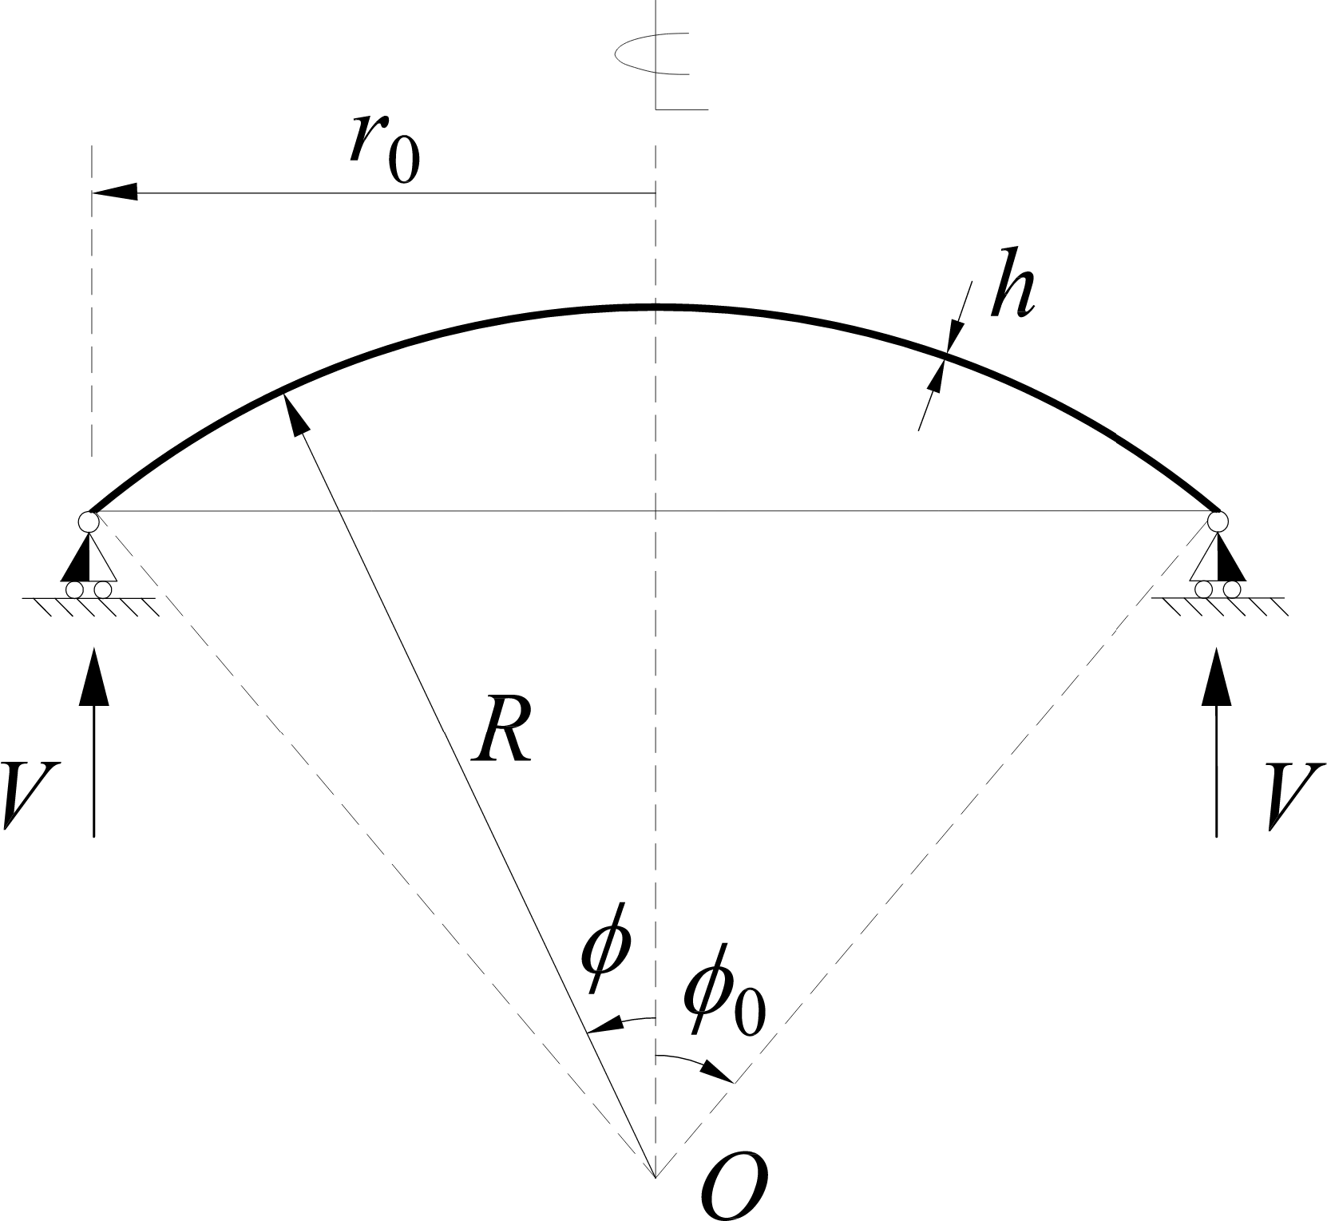
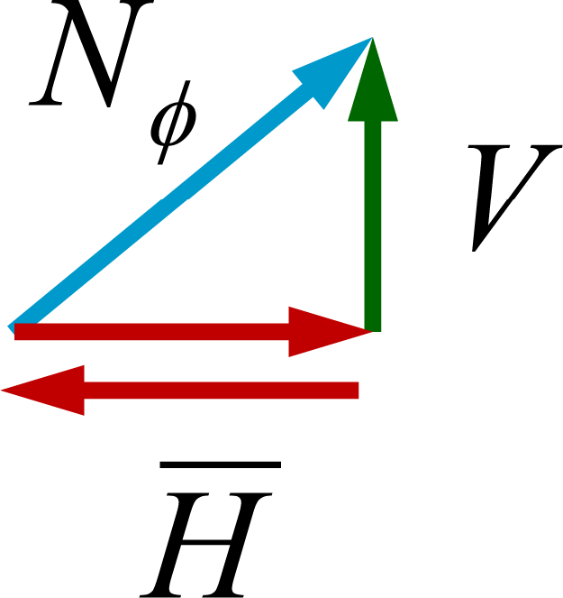
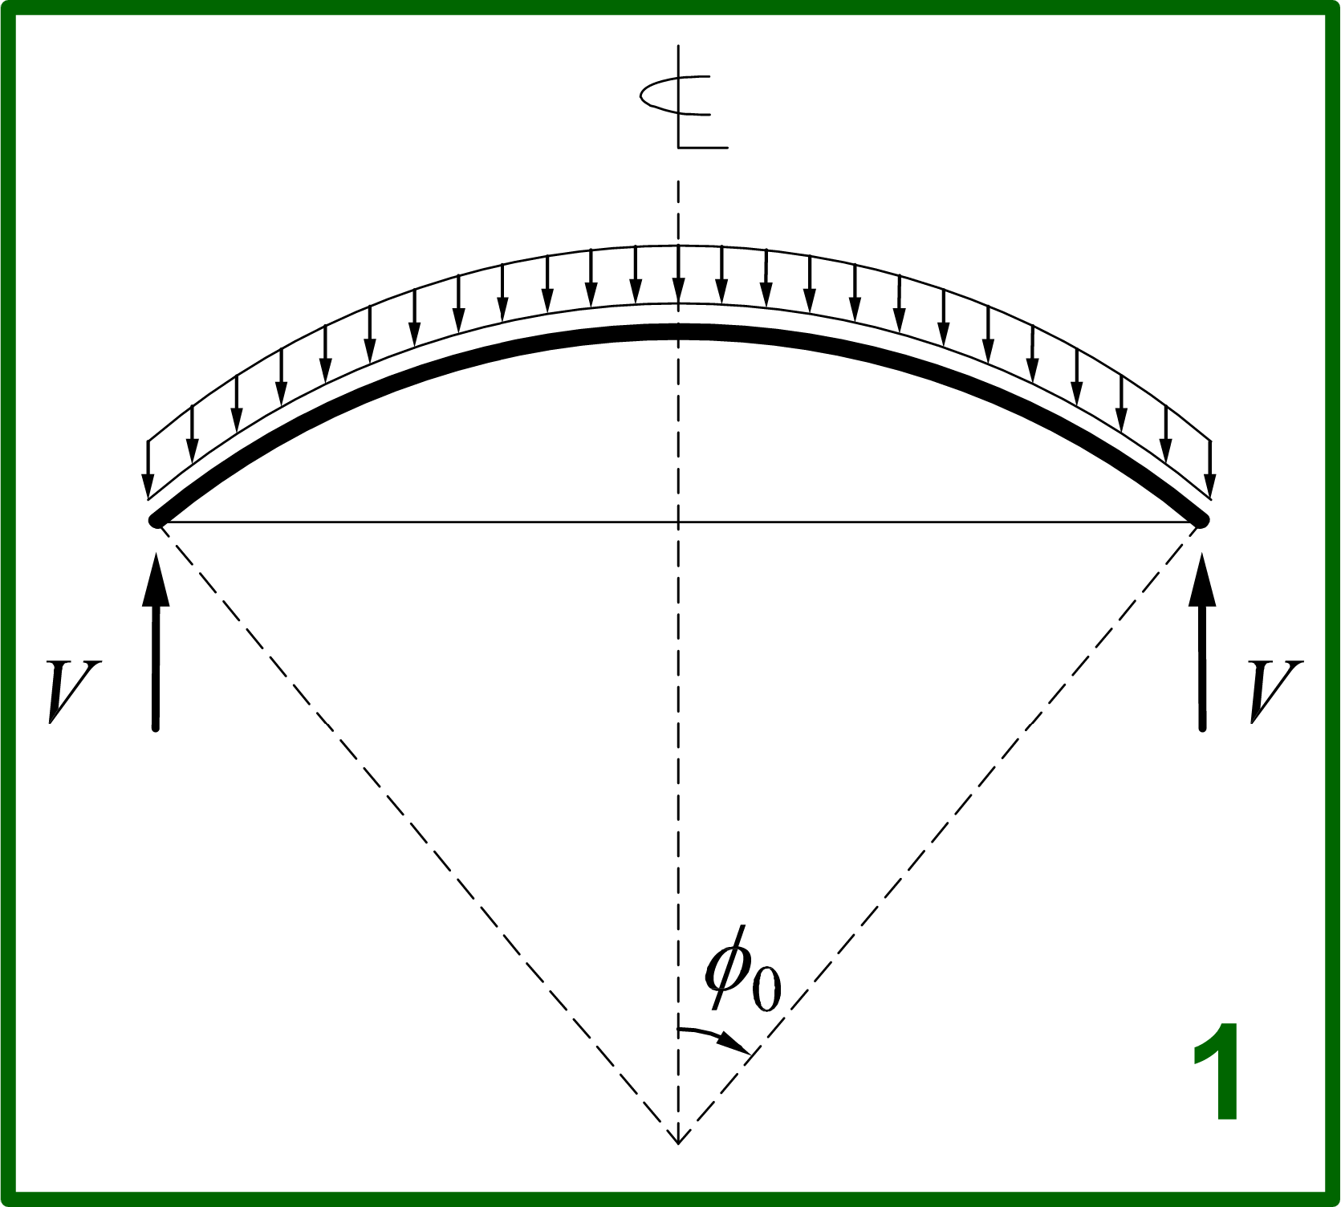
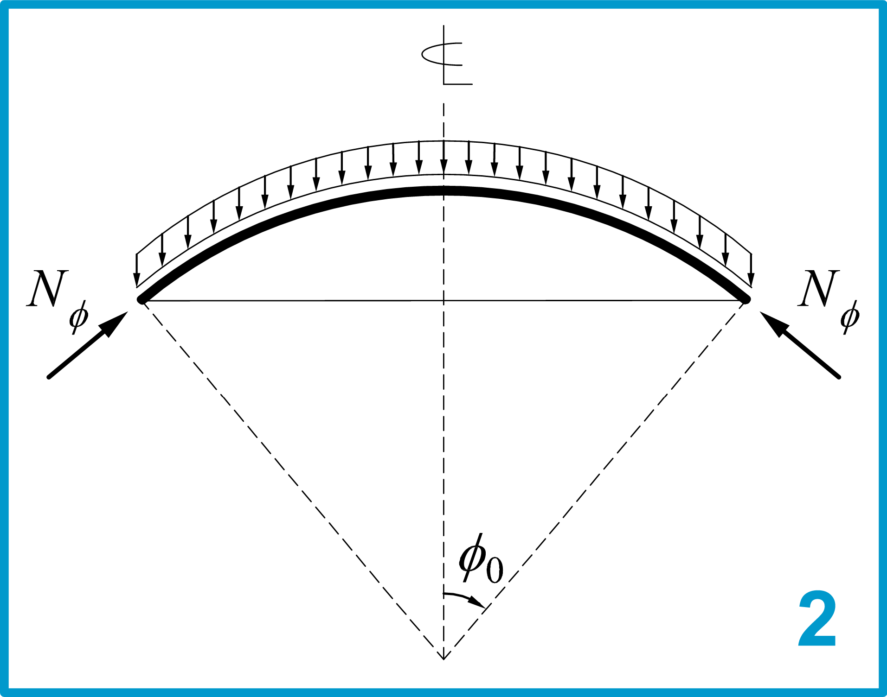
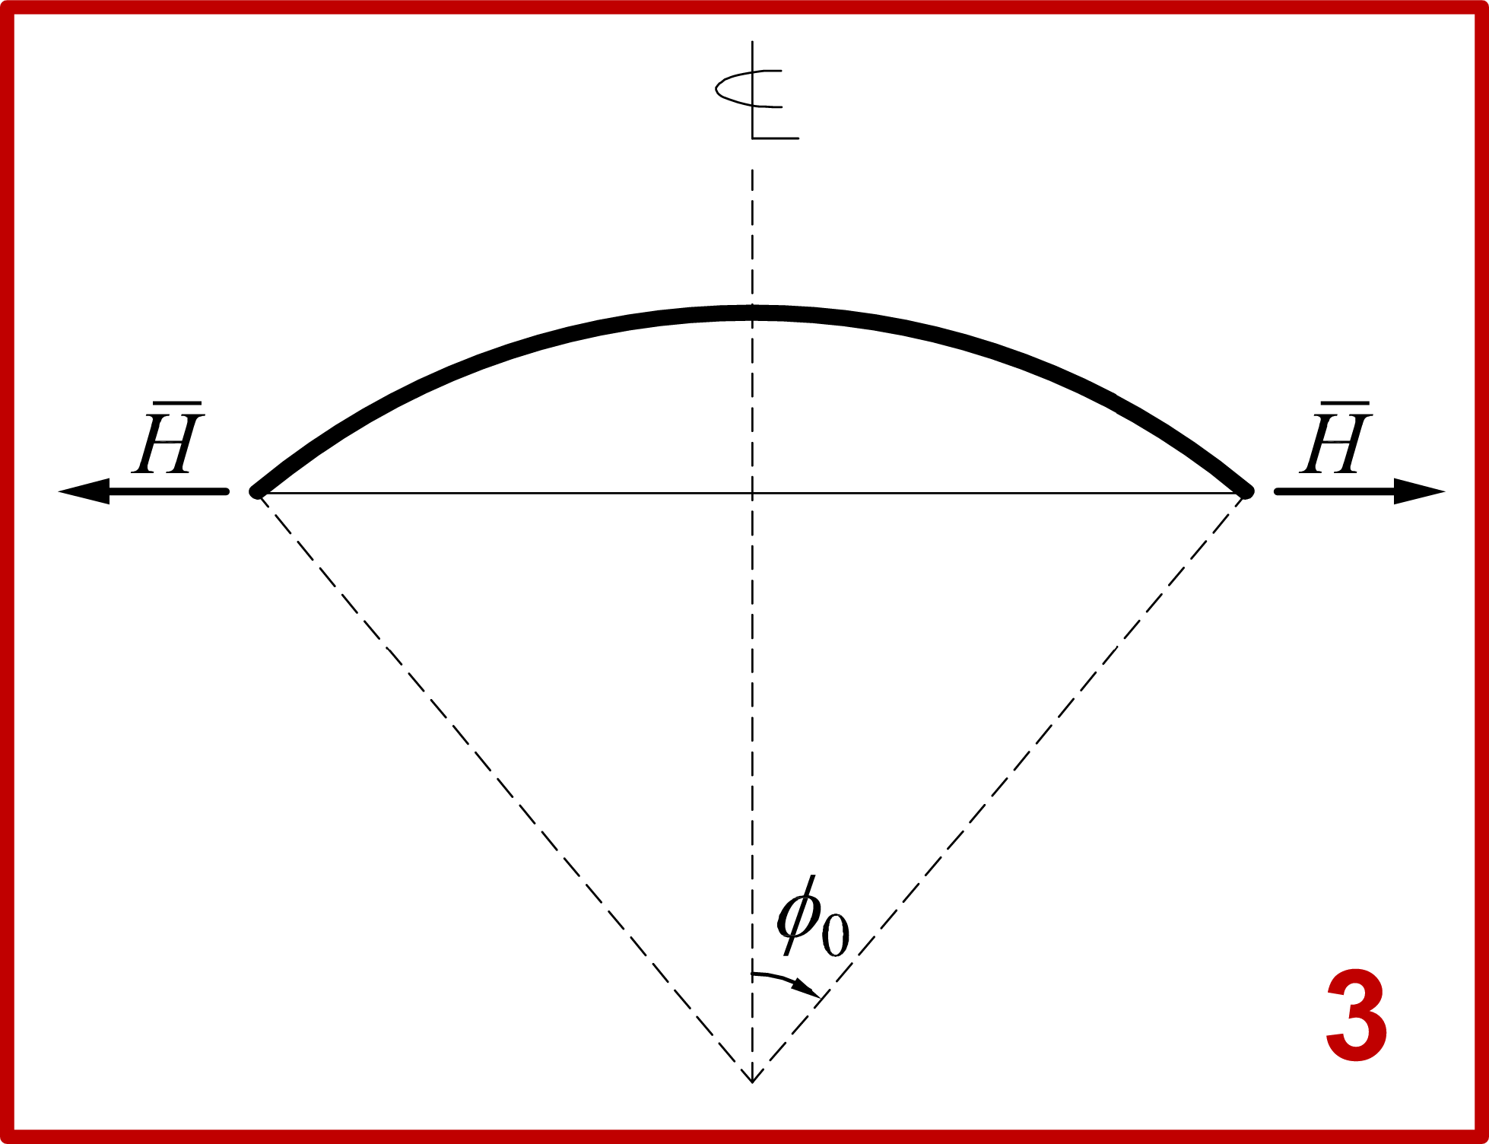
Edge Flexural Disturbance
17 / 53

Slide 19
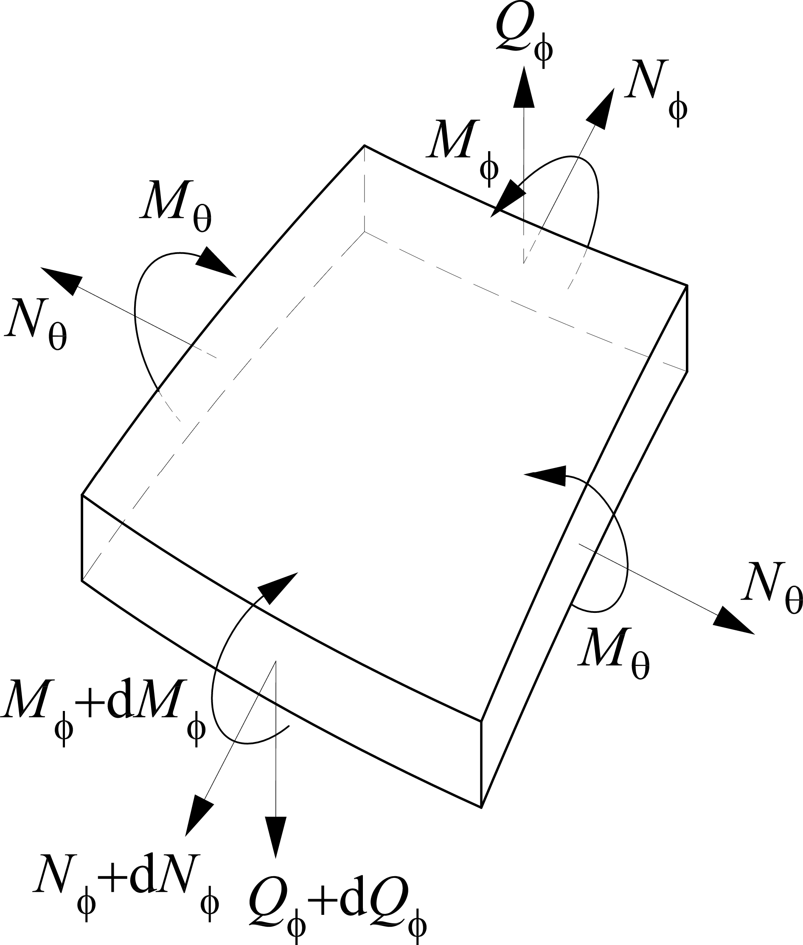
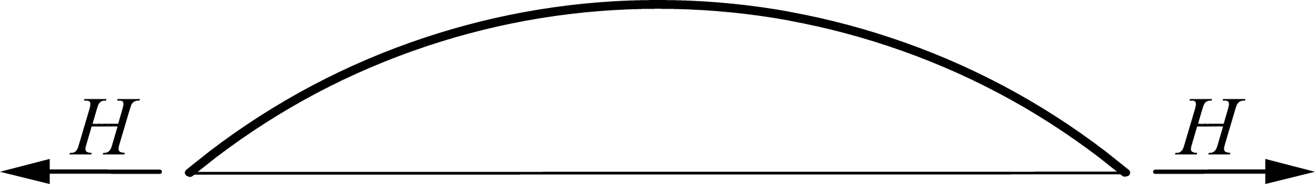
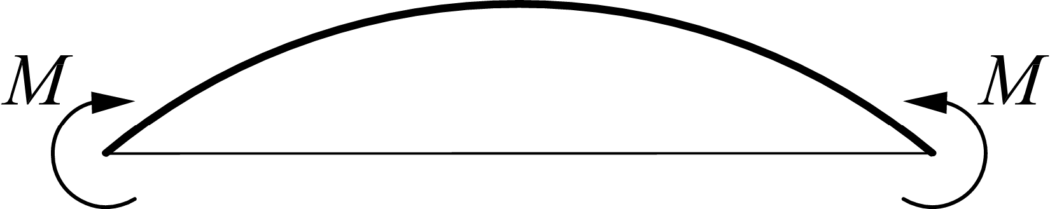
Governing Differential Equations
Homogeneous differential equations
Boundary
conditions
18 / 53

Slide 20
Governing Differential Equations
19 / 53

Slide 21
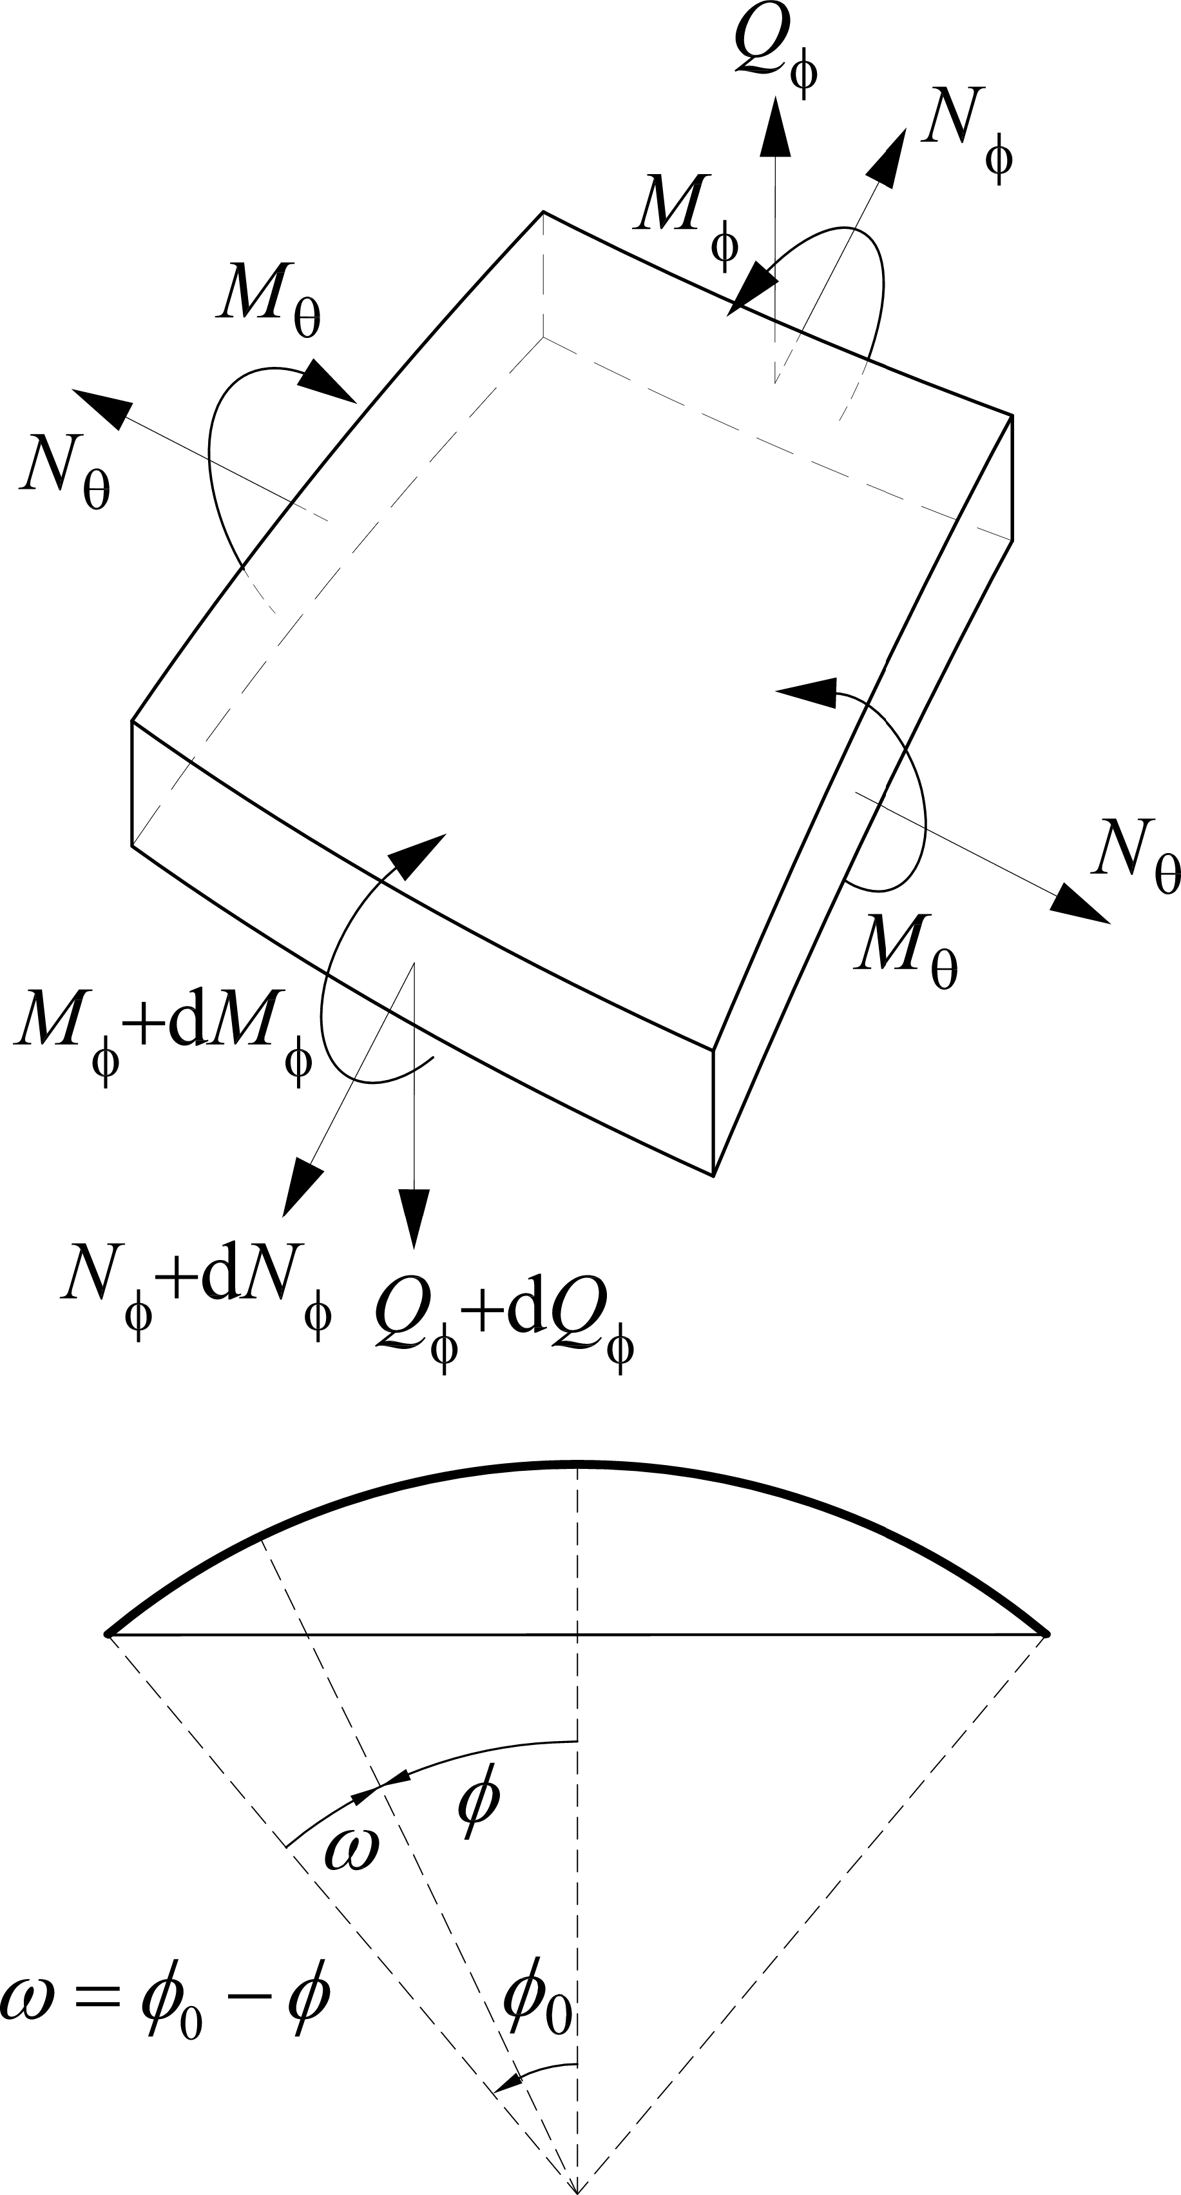
Geckeler Approximation
𝜕⁴𝑄_{𝜙}
⇒
+ 4𝛾⁴𝑄_{𝜙} = 0
𝜕𝜙⁴
20 / 53

Slide 22
Geckeler Approximation
21 / 53

Slide 23
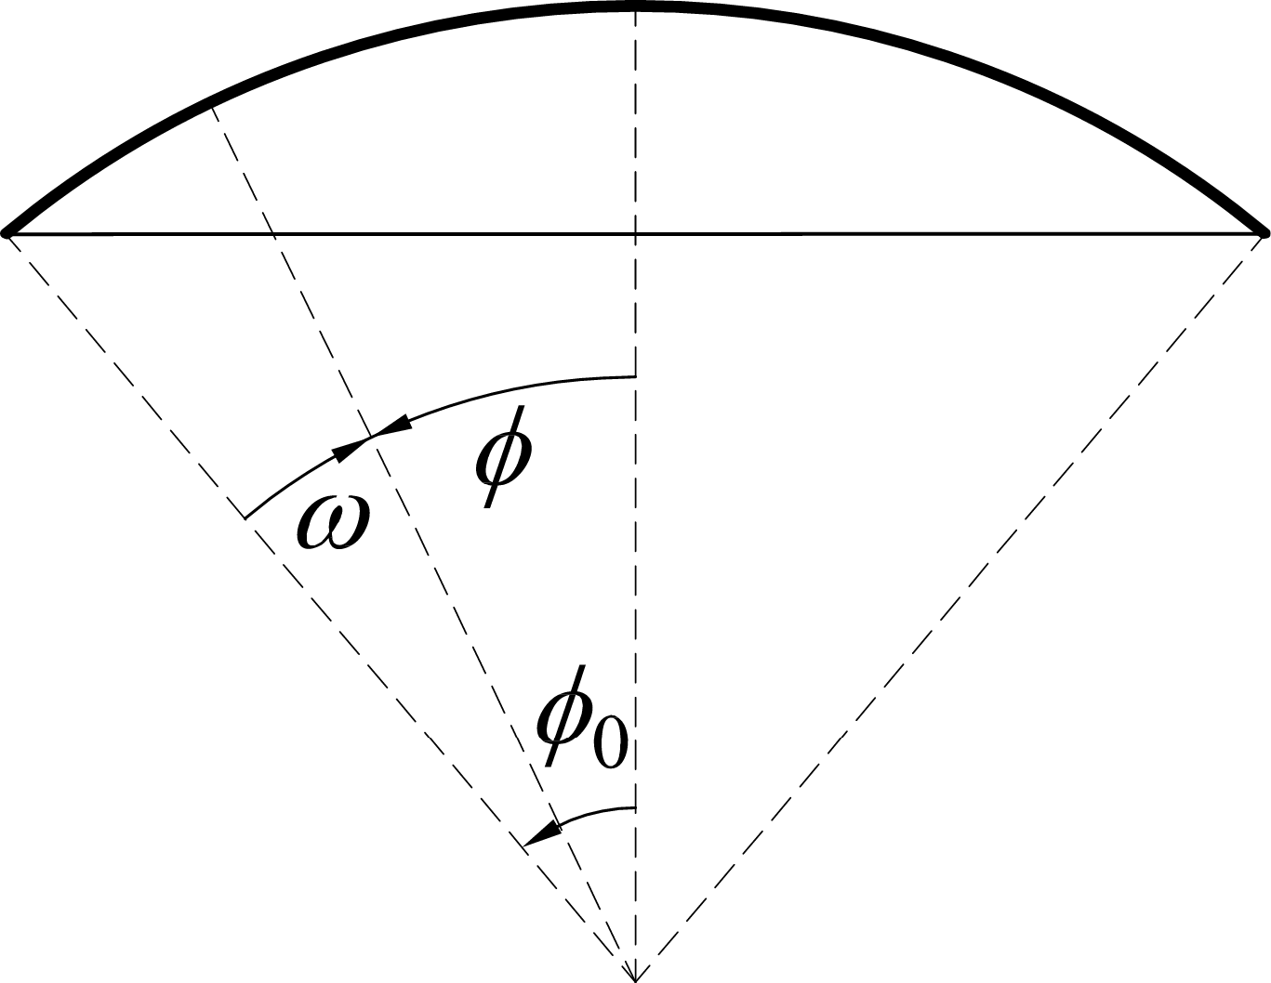
Solution of the Homogeneous Equation
𝜕⁴𝑄_{𝜙}
+ 4𝛾⁴𝑄_{𝜙} = 0
Analogy with Circular
𝜕𝜙⁴
Cylindrical Shells
Angular
Wave Length
𝜆_{𝜔} ≪ 𝜙₀ ⇒
22 / 53

Slide 24
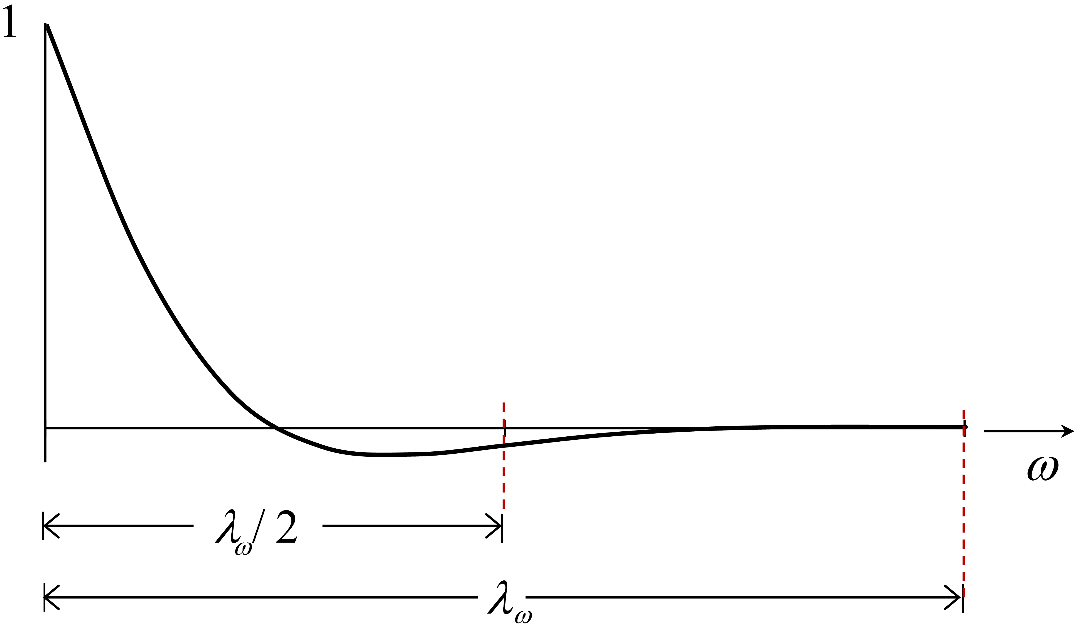
Amplitude decay
23 / 53

Slide 25
Amplitude decay
ℎ = ₂^{𝑅}₀₀ ⇒
24 / 53

Slide 26
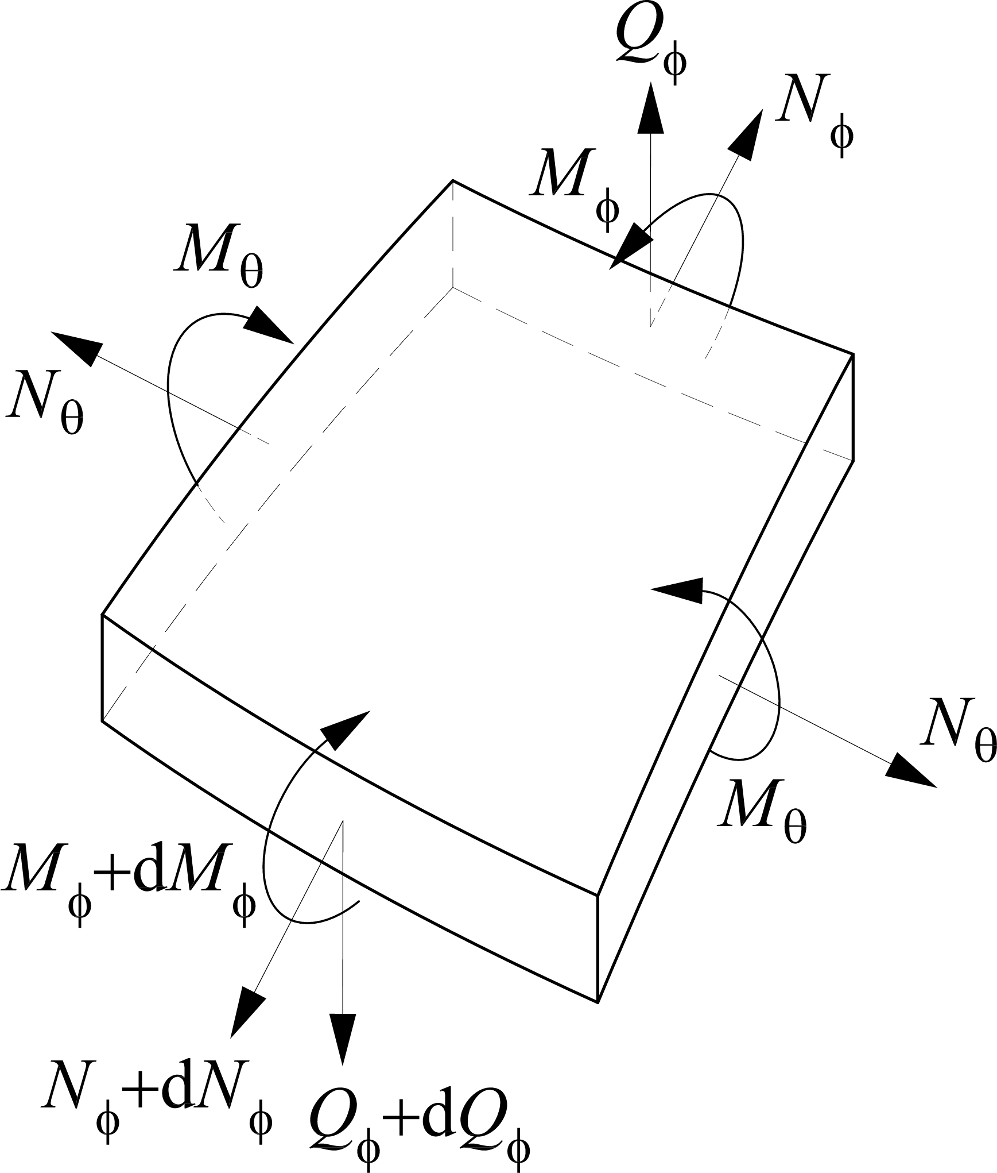
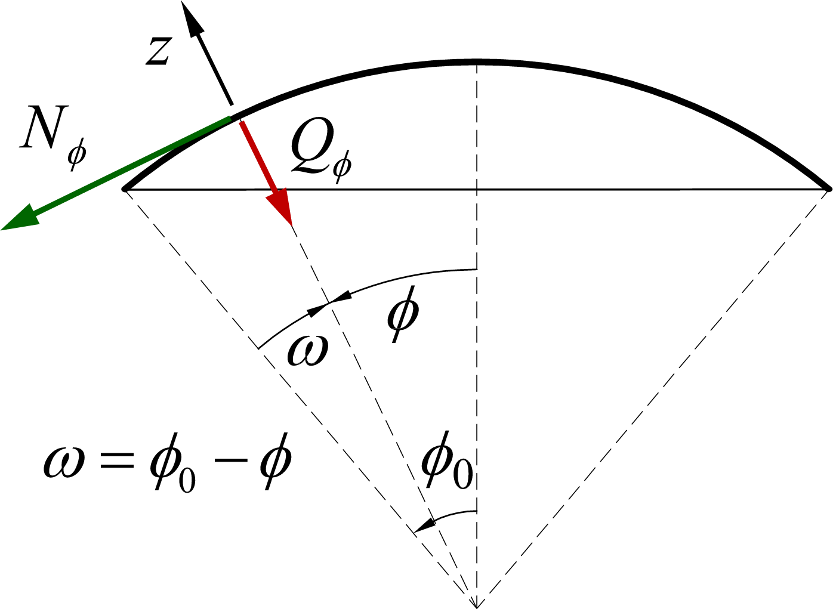
Membrane Forces under Edge Disturbance
Global equilibrium (
𝜈 = 0
)
Local equiibrium (
𝑧 = 0
)
25 / 53

Slide 27
Membrane Forces under Edge Disturbance
26 / 53

Slide 28
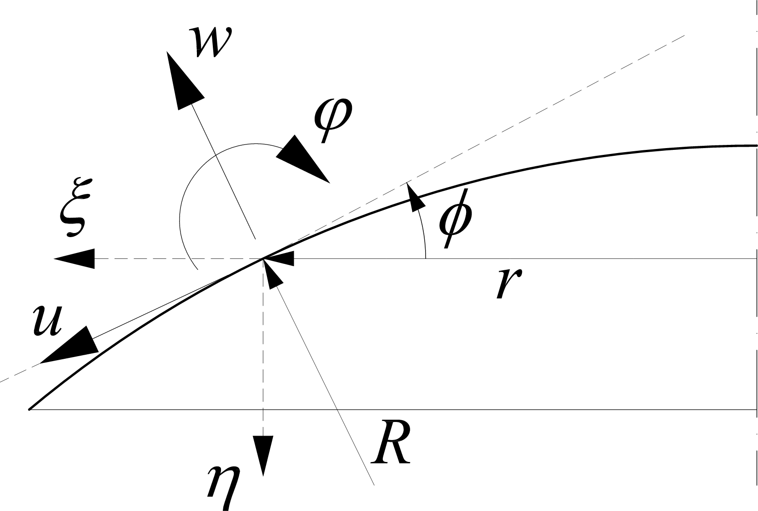
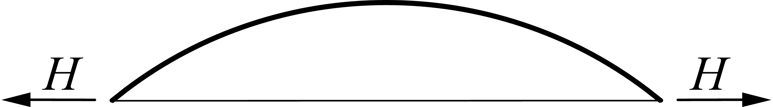
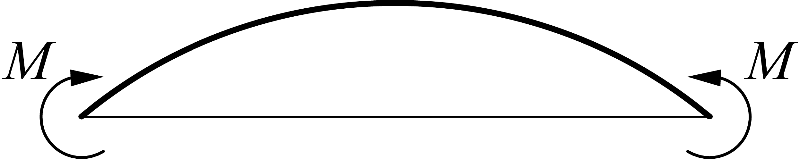
Flexibility Coefficients
Analogy with Circular Cylindrical Shells
27 / 53

Slide 29
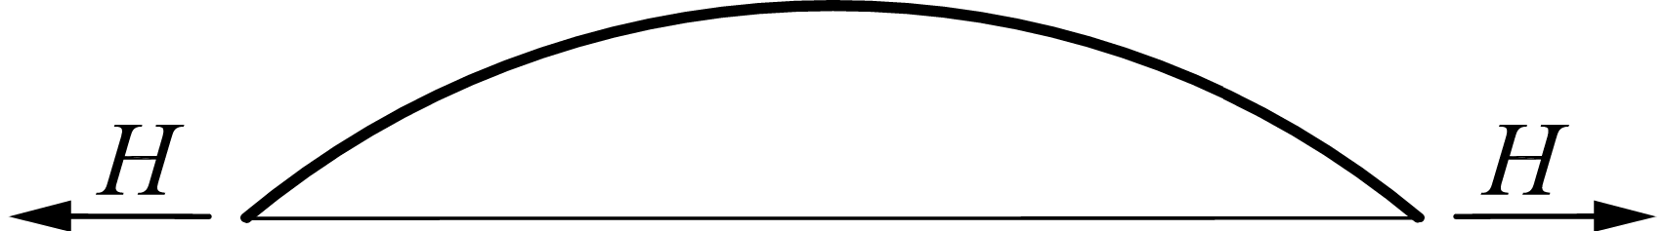
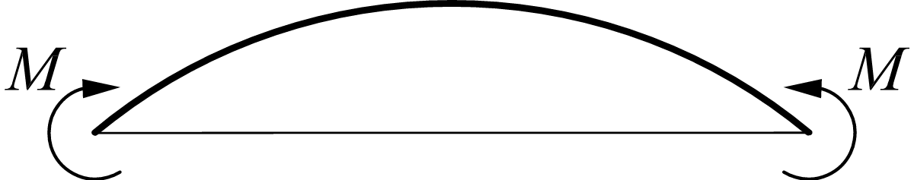
Flexibility Coefficients
28 / 53

Slide 30
Flexibility Coefficients
29 / 53

Slide 31
Flexibility Coefficients
30 / 53

Slide 32
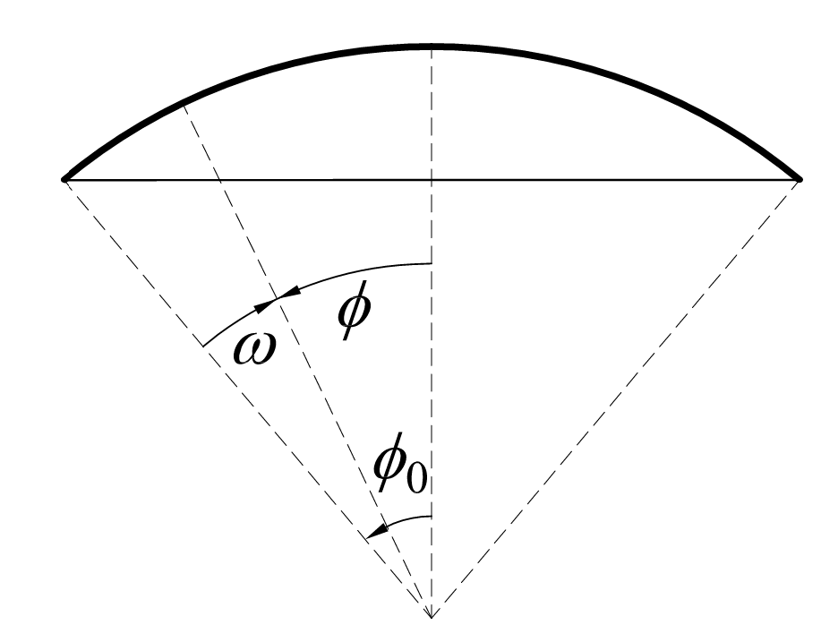
Flexibility Coefficients
31 / 53

Slide 33


Effects of the Edge Flexural Disturbance
32 / 53

Slide 34




Total Membrane Forces
The edge disturbances may lead to unaccept­
able tensile hoop stresses in the concrete
shell. Circumferential prestressing, possibly
combined with ring beams, can be adopted to
eliminate tensile hoop stresses and maintain
a suitable level of residual compressive hoop
stresses (−1.0 to −2.0 MPa).
Prestressing:
33 / 53

Slide 35



Stiffening of the Dome Edge
Note:
Note: Prestressing tendons
and/or wires are subdivided
in two or more portions to
limit the friction losses.
Anchorages may be
circumferentially staggered
at both inner and outer
surfaces, or placed
externally in a thickening of
the beam.
34 / 53

Slide 36



Spherical Shell with Ring Beam
35 / 53

Slide 37

Compatibility Equations (1/2)
36 / 53

Slide 38
Compatibility Equations (2/2)
⇒ 𝑿 = 𝚽^{−𝟏}𝚽_{𝟎}
37 / 53

Slide 39


Combining Different Types of Shells
38 / 53

Slide 40


Idealization and Modelling of Nodal Rings
39 / 53

Slide 41

Steel Reinforcement Layout
40 / 53

Slide 42

Elevated Water Tower with Conical Tank
41 / 53

Slide 43



Conical Shells: Membrane Stresses (1/2)
Warning
Forza peso o pressione del liquido?
42 / 53

Slide 44
Conical Shells: Membrane Stresses (1/2)
43 / 53

Slide 45



Conical Shells: Membrane Stresses (2/2)
44 / 53

Slide 46

Conical Shells: Membrane Displacements
45 / 53

Slide 47
Conical Shells: Membrane Displacements
Note: The radial displacement ξ and the rotation ϕ can be computed independently on the integral
term. The integration constant 𝐶 depends on the boundary conditions and represents a rigid body
46 / 53
motion 𝜂 = 𝐶 along the axis of symmetry.

Slide 48

Membrane Stresses: Self-Weight
47 / 53

Slide 49

Membrane Stresses: Hydrostatic Pressure
48 / 53

Slide 50

Truncated Conical Tank (1/2)
Self-weight
Hydrostatic-pressure
49 / 53

Slide 51
Truncated Conical Tank (1/2)
50 / 53

Slide 52

Truncated Conical Tank (2/2)
51 / 53

Slide 53

Equivalent Spherical Shell
• Flexural stresses and displacements caused by edge disturbances are of local nature and, if the angle φ0 is not small, attain
negligible values at small distance from the edge.
• For rotationally symmetric shells of arbitrary shape, including circular conical shells, the effects of the edge disturbances can hence
be conveniently approximated using the concept of equivalent spherical shell, that is the spherical shell tangent at the edge.
52 / 53

Slide 54
Next lesson
Design of Discontinuity Regions in RC Structures
53 / 53

